Slide 1

Talking about Skin Tones and Skin Colors
Grade K / Lesson 9
UNIT: The Physical World Around Us –
A Celebration of (Skin) Colors

Slide 2

Agenda
  Lesson objective
  Invitations
  Vocabulary
  What is skin?
  How should we talk about different skin colors in a kind and respectful way?
  Activity #1: Naming Crayons
  Activity #2: Nature Walk
  Closing

Slide 3
Objectives
  All skin colors are beautiful and can be expressed in respectful ways.
  Every child should feel comfortable and proud of their skin tone and have rich language to describe their skin color and the skin color of others.
Notes:
Explain to students that today we will be discussing how to talk about our different skin colors in interesting, respectful, and celebratory ways.

Slide 4
Invitations
  Be fully present
  Have an open mind and heart
  Be curious
  Be willing to share
  Be open to reflect
  Listen respectfully

Slide 5
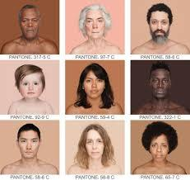
What is skin?
Skin comes in different colors or shades and textures.
What makes it a different color is a pigment called melanin.
When people have more melanin, their skin is darker. When people have less melanin, their skin is lighter.
Notes:
https://news.artnet.com/art-world/4000-skin-colors-in-pantone-squares-1254683
Ask students which people in this photo have more melanin and which have less?

Slide 6
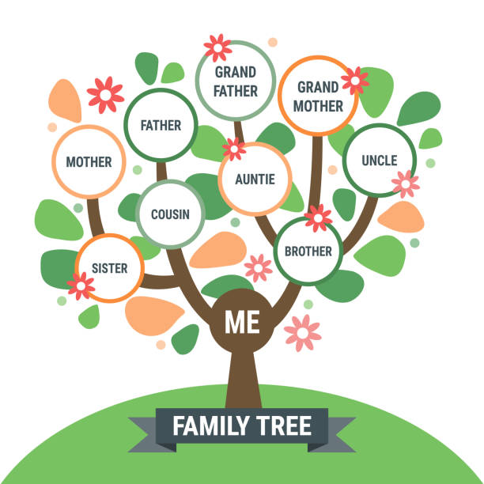
  Depending on where our ancestors came from, we may have more or less melanin.
  An ancestor is someone from your family that came before you.
  Such as your grandmother’s grandmother and all the relatives before her are examples of ancestors.

Slide 7
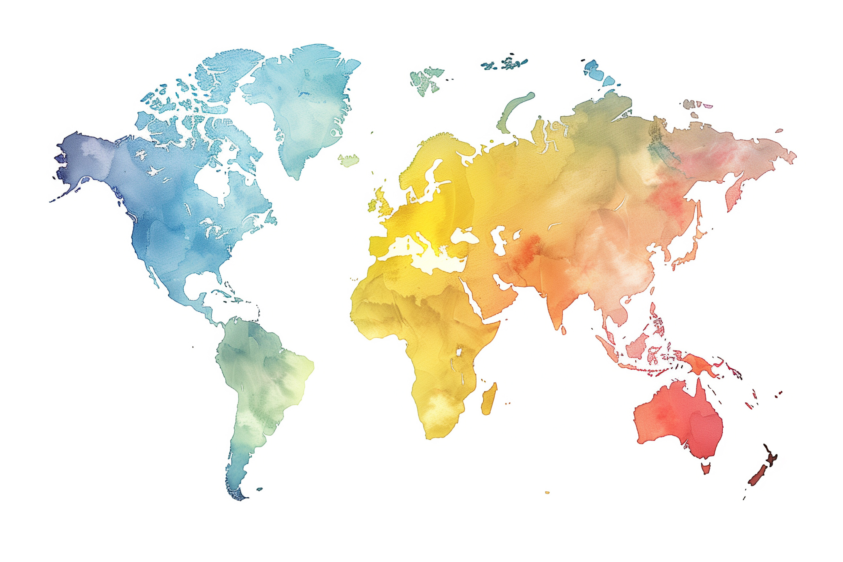
  “A long time ago, before we lived in permanent homes, skin with more melanin helped people live with a lot of sun.
  Skin with less melanin helped
  people live with less sun.
  Now, we live all over the world.
  So, no matter where we live, our skin
  can be different colors.”
  Lesson 7 “What is Skin?”
Notes:
People who live closer to the equator, live in hotter climates, and tend to have darker skin colors. People who live further North and further from the equator live in cooler climates and tend to have lighter skin colors.

Slide 8

How should we talk about different skin colors in kind and respectful ways?

Slide 9
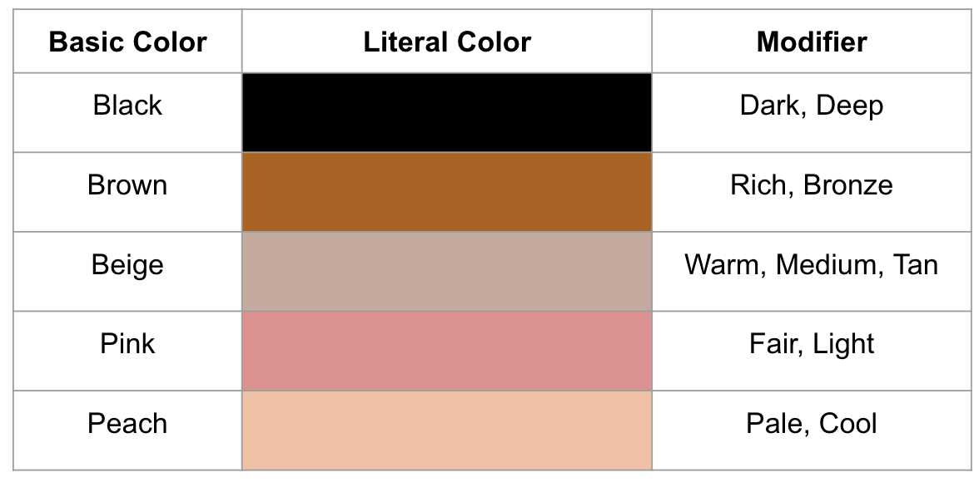
Use vibrant descriptor words!
Notes:
https://britthawthorne.com/blog/diverse-skin-tones/

Slide 10
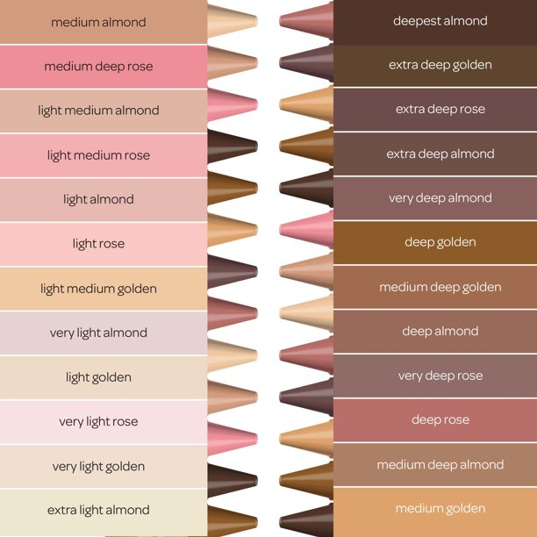
Activity #1
Naming Crayons
Notes:
Pass out skin tone crayons or markers and let students talk about how they would describe the colors. Pass out paper and let them practice drawing and coloring with the crayons and markers.
Show students Crayola's "Color's of the World" crayons and the descriptors that Crayola came up with.

Slide 11
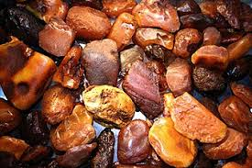
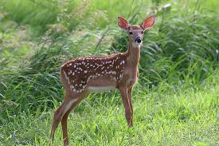
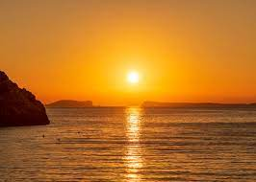
Use Comparisons!
Her skin was golden like a sunset.
His skin is rich brown like a river rock
Their skin is pale pink like a jewel.
Her skin is light brown like a fawn.
Notes:
Try not to overuse comparisons of skin color to food. Why?
Food comparisons tend to be used more often to describe brown melanated skin, such as “mocha caramel” or “chocolate.” We don’t hear light skin equated to food as often.
The edible aspect of these descriptors can sometimes feel more focused on consumption than empowerment.
If a student uses it, that’s fine, there is no need to “correct” them. But as a teacher, provide lots of examples and encourage students to be imaginative in their comparisons.
Encourage students to use comparisons to objects found in nature.

Slide 12
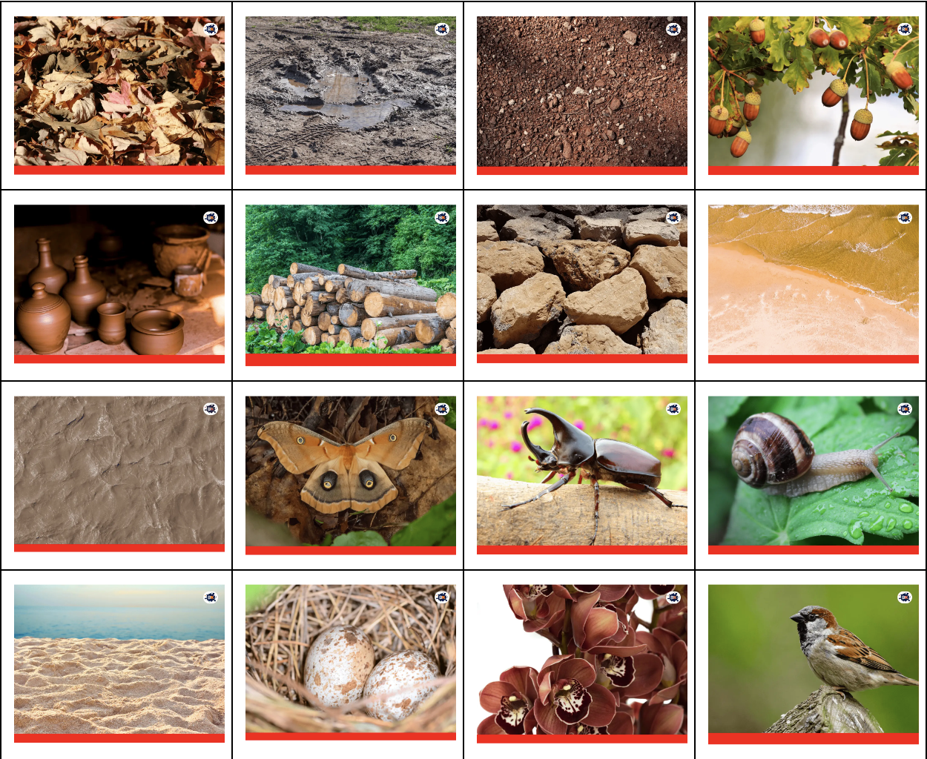
Activity #2
Nature Walk
Can you find objects in nature that mimic skin tones?
Notes:
If possible, take your students outside! Have them observe their natural surroundings and consider things in nature that mimic different skin tones. Examples could be: wood, soil, tree bark, acorns, fallen leaves, seeds, mushrooms, flowers, snow, clouds, clay, logs, rocks, silt, moths, shells, beetles, caterpillars, eggs, snails, sand, birds, pebbles, etc.
Allow students to collect these items to display in the classroom or take photos or allow students to track the natural objects they observe on a Nature Walk Worksheet

Slide 13
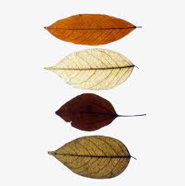
Closing
Let’s share what we learned on our nature walk!
Notes:
Some students may be able to find lots of natural objects that reflect their skin color and some may not, which is ok.
Encourage students to consider variations of color tone and practice describing them.
Model describing your own skin color and encourage them to do the same.
“My skin color is a little pinker than this clay”
“My skin color is a little deeper than this dried leaf”

Slide 14
Extension Activities
Read Skin Again a book by Bell Hooks and Chris Raschka or read the Skin Again Poem.
Have students describe the paint colors Chris Raschka chose for different skin.
ASK STUDENTS
Why does the author say, “skin is just a covering?”
Why does the author mean when they say, “come inside?”
How do we let others know what we are really like?

Slide 15
Extended Learning for Educators
Navigating Harmful Comments about Skin Color
SCENARIOS

Slide 16
Scenario #1
A non-Black student in your classroom says to a Black student, “Your skin looks like poop.”
SOME STRATEGIES WE COULD CONSIDER:
Always address moments of harmful behavior calmly and use it as an opportunity to teach important values like empathy and kindness. If the behavior persists or if you notice a pattern of inappropriate comments, it might be necessary to involve the children's parents or guardians to address the issue collaboratively.
Address the comment calmly and directly
"We don't say things that might hurt someone's feelings."
"It's not nice to compare someone’s skin color to poop, and we don’t say hurtful things.”
“How would you feel if someone said something unkind about your skin color?"
Promote positive language
We use words to make our friend feel good about themselves.
Give examples of positive ways we describe brown skin (refer to lesson).
Privately check in and affirm the Black student
Ask the child how the comment made them feel and let them know it’s ok to share their feelings and that we all deserve to feel respected.
Affirm the child and model ways to talk about brown skin in a positive way
  - "His complexion is beautiful, golden brown, like the color of sun-kissed sand."
  - "Her skin has a warm, rich brown tone that glows in the sunlight."

Slide 17
Scenario #2
During the lesson, a student refers to a peach-colored crayon as “skin-colored.”
SOME STRATEGIES WE COULD CONSIDER:
Approach the situation with empathy and a calm non-judgmental demeanor. Children are often not aware of the implications of their language, and your gentle guidance can contribute to a more inclusive and respectful environment.
Consider context, perhaps the peach crayon IS the color of the child’s skin color. If this is the case you can say, “Yes, this crayon is the color of YOUR skin color”
The term "skin-colored" can be subjective and vary widely based on individual skin tones.
Also consider:
Pointing out that skin comes in a variety of colors, and using the term "skin-colored" may not be inclusive of everyone. Encourage awareness of and respect for different skin tones.
Instead of using a broad term like "skin-colored," encourage the student to use descriptive words to describe the color more precisely. For example, you might suggest saying "peach," "beige," "light brown," or another term that accurately describes the color.

Slide 18
Resources
https://news.artnet.com/art-world/4000-skin-colors-in-pantone-squares-1254683
https://britthawthorne.com/blog/diverse-skin-tones/
https://www.google.com/url?q=https://www.prnewswire.com/news-releases/crayola-announces-new-colors-of-the-world-crayons-to-help-advance-inclusion-within-creativity-301063370.html&sa=D&source=editors&ust=1703695060706513&usg=AOvVaw186EE24WTvsBjl0nW0EJUD

Slide 19
Email: info@pollyanna-us.org
Website: www.pollyanna-us.org
SOCIAL MEDIA
Facebook / Instagram: @us_pollyanna
LinkedIn: Pollyanna-us

Slide 20


