Slide 1

Voices from Today––Speaking Out Against
the Single Story
Grade 6 / Lesson 9
UNIT: The Historical Construction of Race and Current Racial Identities Throughout U.S. Society

Slide 2


Photo by Max van den Oetelaar on Unsplash
Notes:
Invite students to wiggle their bodies into a comfortable position and then lead them through a simple breathing or mindfulness exercise.
Examples:
1-minute of mindful breathing
(fake) Yawn & 10 second stretch - notice and “greet” any tension or tightness
Self-Love Hug w/ 3 deep breaths
Hand stroke - with eyes cast or closed, using index finger of one hand, gently trace the outside of all fingers on the opposite hand, then switch hands
full body scan - noticing any tension, sensations, or emotions in different parts of the body
Remind students that slowing down to breath in this ways helps us to stay calm and focused.

Slide 3
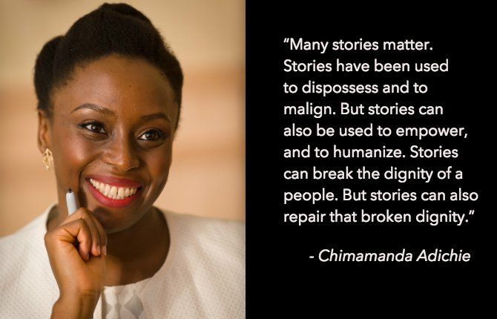
Notes:
Earlier this year we watched Chimamanda Adichie’s TED talk, the Danger of a Single Story.
Here is a quotation by her. Would someone like to read it?
What do we think Adichie means?
Every human society tells stories about different groups of people. Sometimes those stories are ungenerous and harmful. And when they are, people are treated poorly and suffer. However, we can all learn to tell better stories about people and learn to treat them better.
We can begin by listening to people’s stories about themselves and their experiences and about how they want to be treated.

Slide 4

Notes:
Let’s read an excerpt from Jewell’s “This Book is Anti-Racist.”

Slide 5
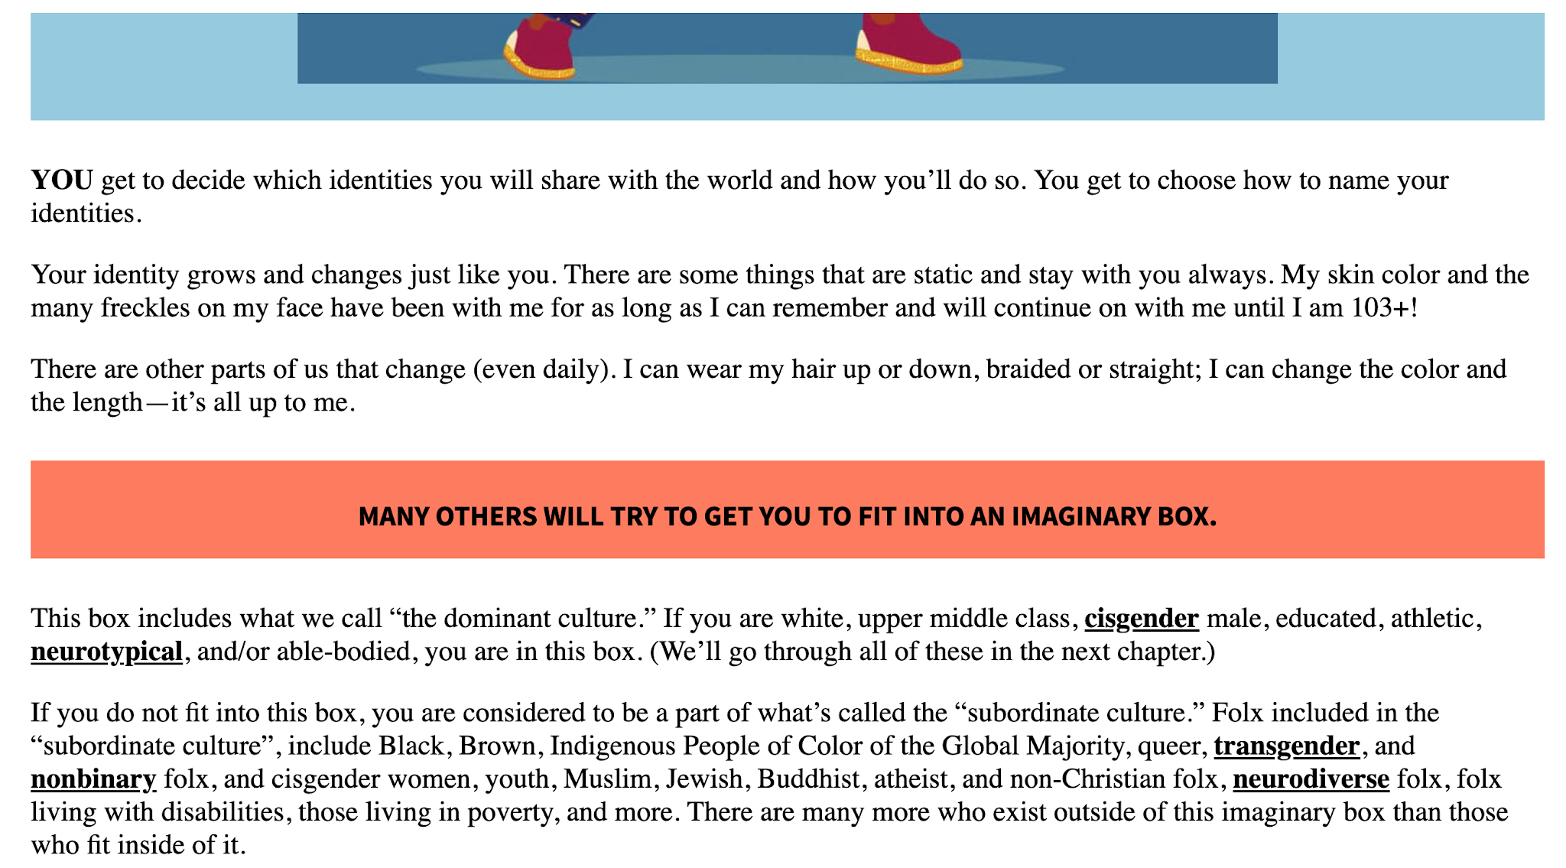

Slide 6
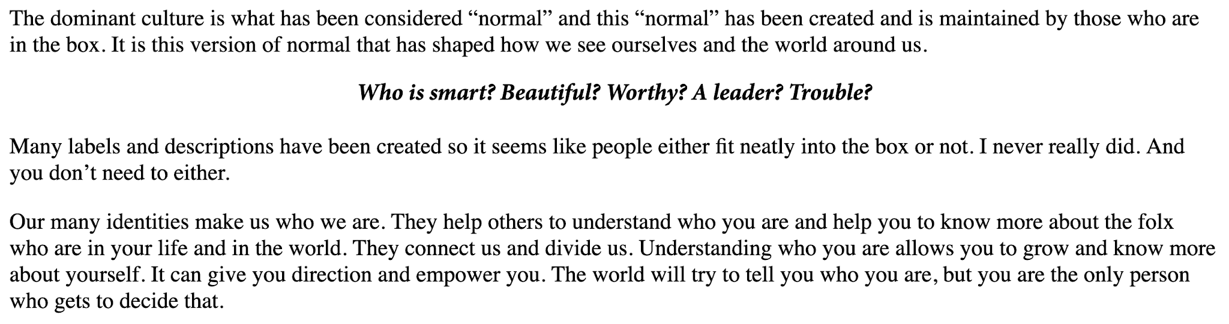

Slide 7
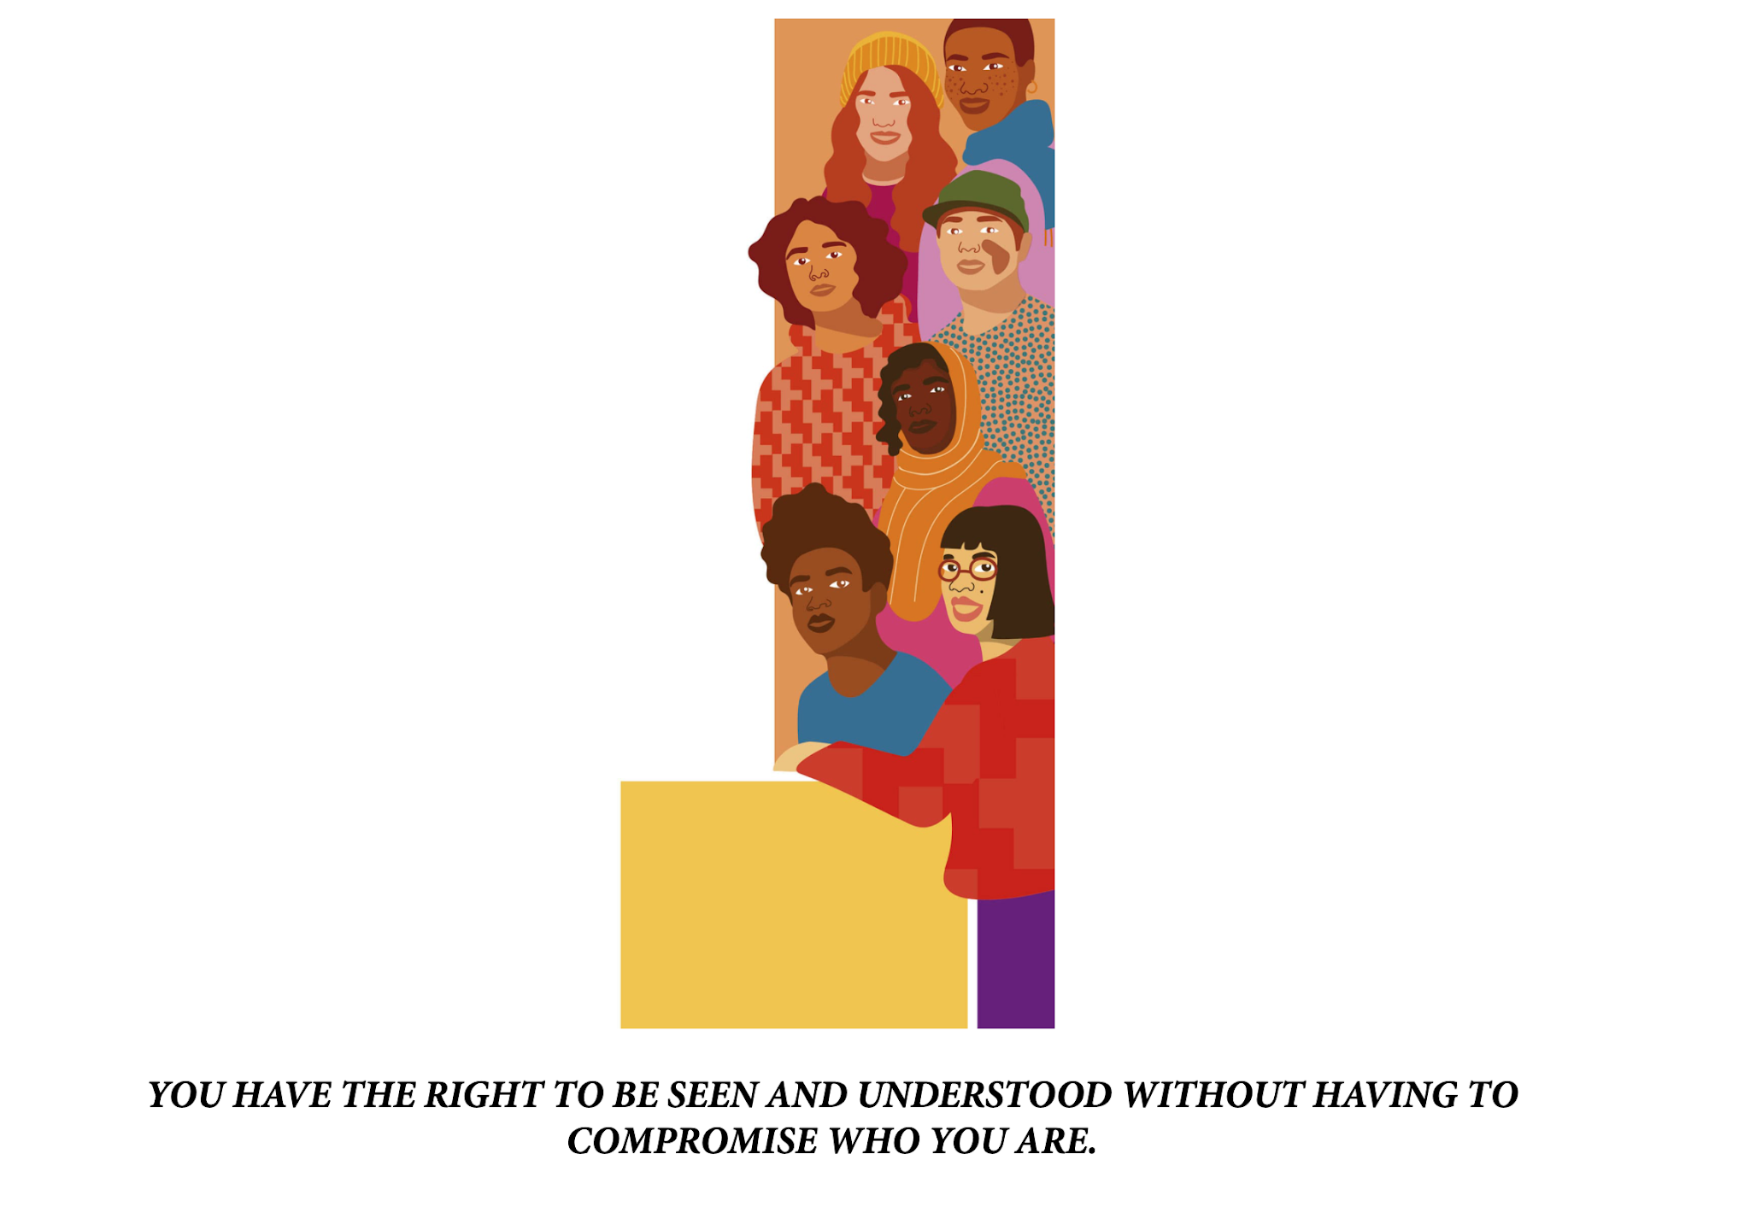

Slide 8
Notes:
How does Adichie’s thinking connect with what we just read from Jewell’s work?
I am going to ask you to free-write a few thoughts in response.
Now I am going to ask you to talk with a neighbor about the ideas you wrote about.
I would love to hear a few people share with the large group what they wrote about or what came up in their conversations.

Slide 9
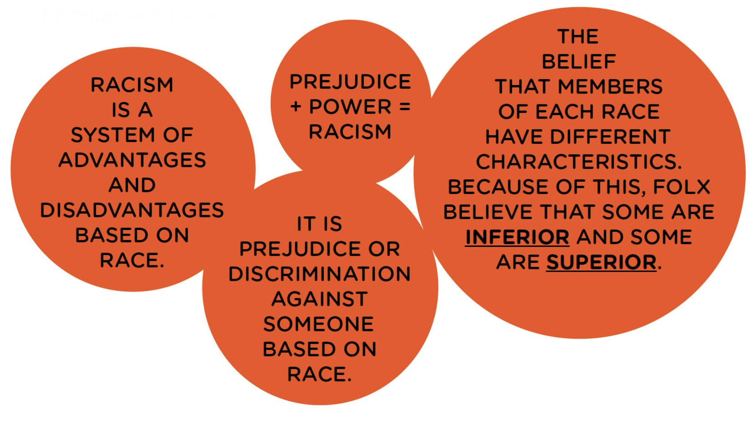
Notes:
Let’s go back to Jewell’s book where she defines racism.
Would anyone like to read two circles on the screen?
Bad stories about people on the basis of race creates mistreatment of those people. That is true historically – and it is true of how people have been treated even today.

Slide 10
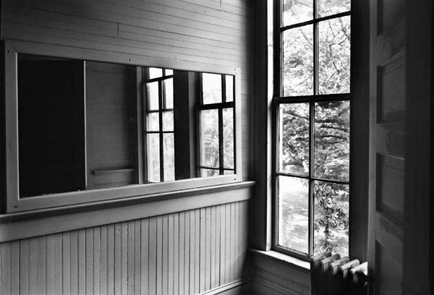
Notes:
So now we are going to watch a series of short films produced by the New York Times. Each film focuses on the experiences of a different racial group. We will watch two films and then have a short discussion on them. Then we will watch another two films, followed by discussion. Afterwards, we will watch one more film and close with one final discussion. As you watch each film, please consider which film or films serve as a mirror for your own experiences with racial and which film or films serve as a window into the experiences of others who have different racial identities than your own.

Slide 11
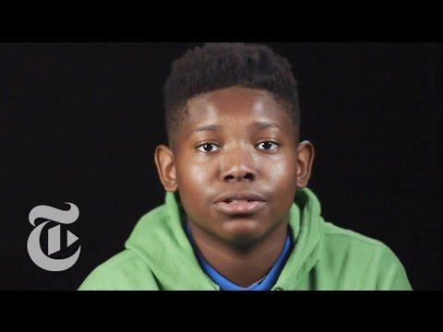
A Conversation with Black People on Being Black

Slide 12
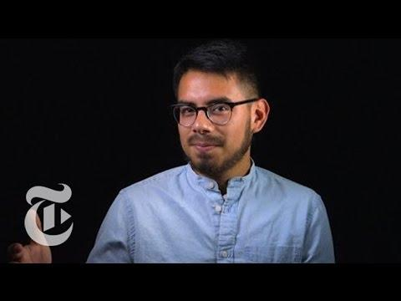
A Conversation With Latinos on Being Latino/a/e

Slide 13
Let’s Discuss!
In what way did this film serve as a mirror for you? In what way did this film serve as a window for you?
What stood out to you? What surprised you? What didn’t?
How would you compare and contrast the films?
Notes:
Now that we have watched two clips, I am going to ask you to turn to a neighbor or two and discuss these questions.

Slide 14

Would you share a point or two that came up in your discussion?
Notes:
Now that we have watched two clips, I am going to ask you to turn to a neighbor or two and discuss these questions.

Slide 15
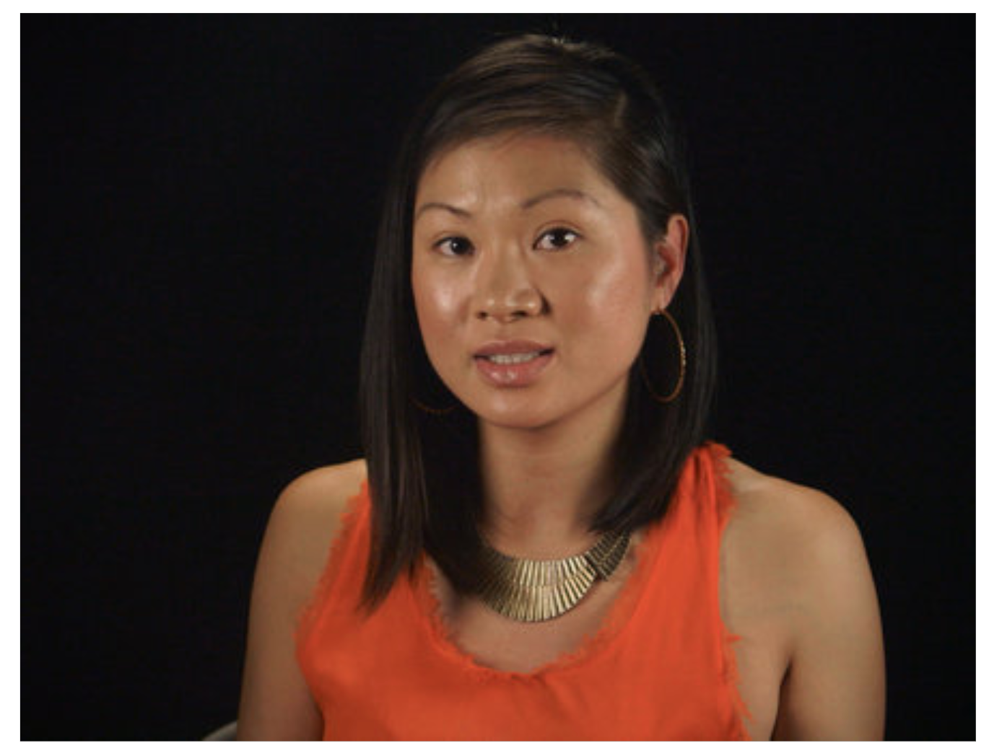
A Conversation With Asian Americans About Race

Slide 16
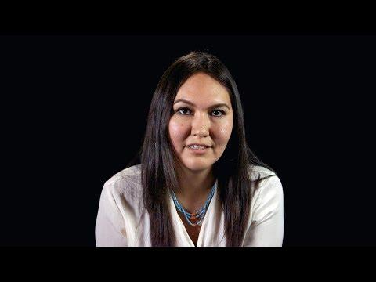
A Conversation With Native People on Being Native

Slide 17
Let’s Discuss!
In what way did this film serve as a mirror for you? In what way did this film serve as a window for you?
What stood out to you? What surprised you? What didn’t?
How would you compare and contrast the films?

Slide 18
Would you share a point or two that came up in your discussion?

Slide 19
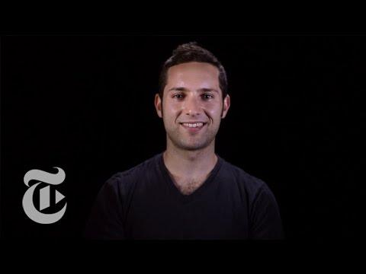
A Conversation With White People on Race

Slide 20
Let’s Discuss!
In what way did this film serve as a mirror for you? In what way did this film serve as a window for you?
What stood out to you? What surprised you? What didn’t?
How would you compare and contrast the films?

Slide 21
Would you share a point or two that came up in your discussion?

Slide 22
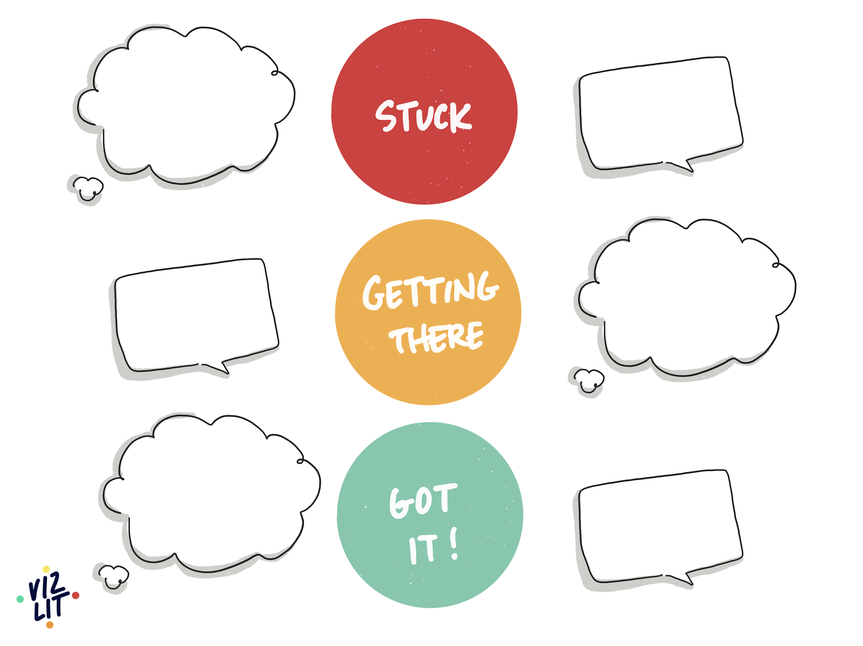
Stuck,
Getting there,
Got it
Notes:
Now that we have moved through this conversation. I’d like to give you an opportunity to journal in response to the prompt on the screen.
Explain the prompt.
Provide time for students to write and then to share some thoughts out loud before closing class.

Slide 23
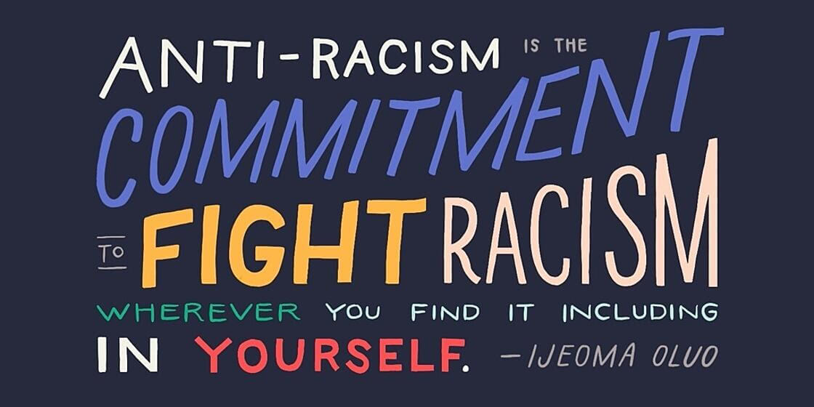
Notes:
Thank you so much for participating so fully in our session today. Through several exercises and dialogue, we explored a mirrors and windows approach to sharing our stories of race and identity and to developing a sense of empathy across lines of racial difference. The more self-aware we become about the power of race in our world, the more self-aware we become about how race has impacted us, giving some of us advantages and others of us disadvantages, the more we can work across racial lines to change things for the better.
We can commit to speaking out when we hear racist comments. We can commit to challenged racist ideas and beliefs. We can commit to having hard conversations with friends and families. We can be more sensitive with our own language, more inclusive and just with our own actions. And we can commit to ongoing learning.
Would someone like to read this quotation to close class?

Slide 24
Extended Learning for Educators
Navigating Trick Comments
SCENARIO

Slide 25
Scenario #1
A student says “The idea of white privilege doesn’t make sense to me. Some of my white relatives are poor, and I don’t think they have privilege.”
SOME STRATEGIES WE COULD CONSIDER:
Identity is complex as are the advantages and disadvantages that can accrue to us on the basis of our social group memberships. Many of us experience advantages because of particular identities that we carry, which are favored in the broader society, while, at the same time, experiencing disadvantages because we hold unfavored identities. Both of these realities often exist in the same human experience. It is therefore possible to be white and poor, to be racially advantaged and economically disadvantaged. One identity does not cancel out the other identity. When talking with students, affirm how complex identity can be and share that it is possible to be privileged in some ways and disadvantaged in others–at the same time.
Affirm the complexity of identity.
“Identity is really complex, and I think your comment is speaking to that.”
“Thank you for sharing this reflection with us. I think you are right that identity is complex, and so we should try to speak about it in ways that allows us to see the full picture.
Share that dual experiences are possible.
“None of us is only one identity. We all carry multiple identities. It is therefore possible to be white and poor at the same time and to benefit from society’s perceptions of being white and to be harmed by how society treats people who are poor.”
“All of us have privilege in some degree, and all of us have experienced being outsiders to some degree. Those experiences stand on their own and do not cancel each other out.”

Slide 26
Email: info@pollyanna-us.org
Website: www.pollyanna-us.org
SOCIAL MEDIA
Facebook / Instagram: @us_pollyanna
LinkedIn: Pollyanna-us

Slide 27


