Slide 1
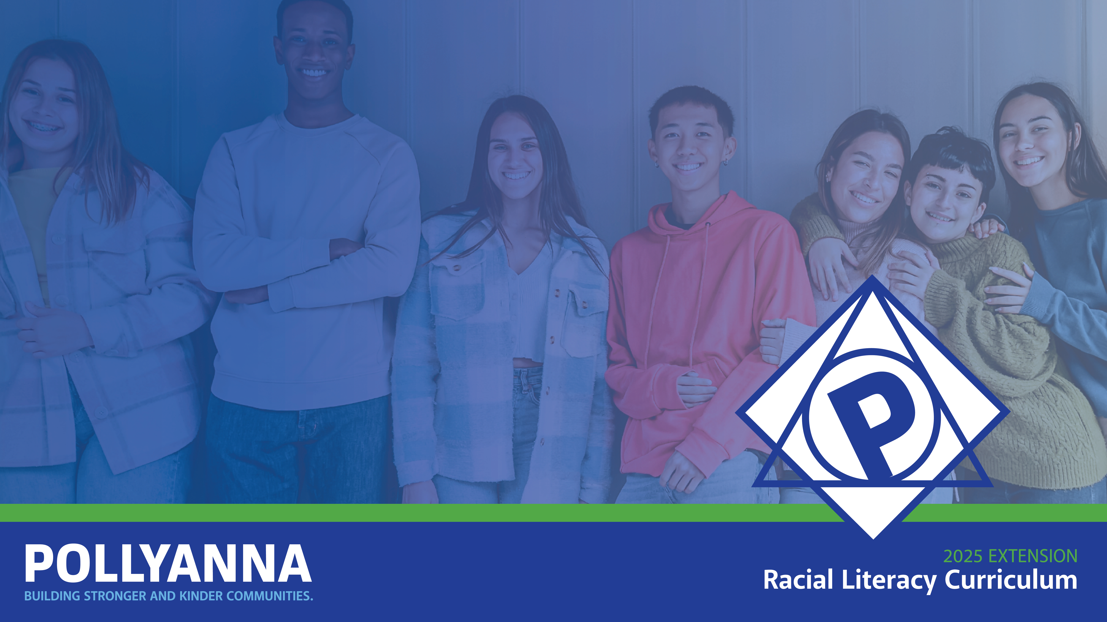
Interracial Friendships: Then and Now
Grade 5 / Lesson 9
UNIT: How "Immigration" Shaped the Racial and Cultural Landscape of the United States

Slide 2


Photo by Max van den Oetelaar on Unsplash
Notes:
Invite students to wiggle their bodies into a comfortable position and then lead them through a simple breathing or mindfulness exercise.
Examples:
1-minute of mindful breathing
(fake) Yawn & 10 second stretch - notice and “greet” any tension or tightness
Self-Love Hug w/ 3 deep breaths
Hand stroke - with eyes cast or closed, using index finger of one hand, gently trace the outside of all fingers on the opposite hand, then switch hands
full body scan - noticing any tension, sensations, or emotions in different parts of the body
Remind students that slowing down to breath in this ways helps us to stay calm and focused.

Slide 3
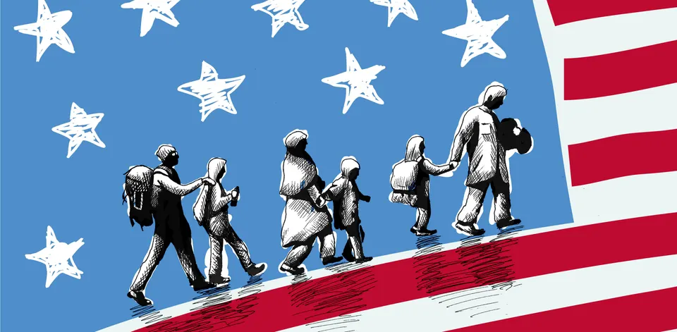
Notes:
We’ve spent time this year studying how immigration, both chosen and forced, shaped what became known as the United States – and we will add internal migration to that idea, where people, in this case, U.s. Americans, move around the country.. Every area of life in the U.S. has been touched by immigration – even the most intimate parts of our lives – including friendships and relationships. With internal migration and immigration in the U.S., the opportunities for cross-racial and cross-cultural relationships have grown exponentially. Today we will explore this reality.

Slide 4
Friendships & Relationships Across Differences
Benefits | Challenges
Notes:
With a more diverse society, there is greater opportunity for friendships and relationships across racial and cultural lines. Immigration has helped to create the context for this.
What might be some of the benefits of friendships and relationships across differences? What might be some of the challenges?

Slide 5
Big Idea
  A study in Psychological Science reports that students who have relationships with students who are different from them, and who get to learn new ideas and diverse perspectives that these relationships bring, tend to better skills for thinking creatively and critically about important issues.
  Why do you think this is true?
Notes:
A study in Psychological Science reports that students who have relationships with students who are different from them, and who get to learn new ideas and diverse perspectives that these relationships bring, tend to better skills for thinking creatively and critically about important issues. Why do you think this is true?
One challenge is how racism and a fear of difference can get in the way of these meaningful connections.
Let’s jump to the present and watch this clip of two young girls navigating their interracial friendship.

Slide 6
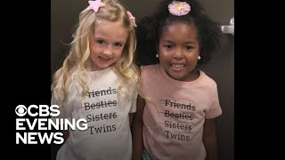
Notes:
What struck you about what you just heard?
How does it relate to your own experience?
How did we get here as a society such that two girls in an interracial friendship would become newsworthy?

Slide 7
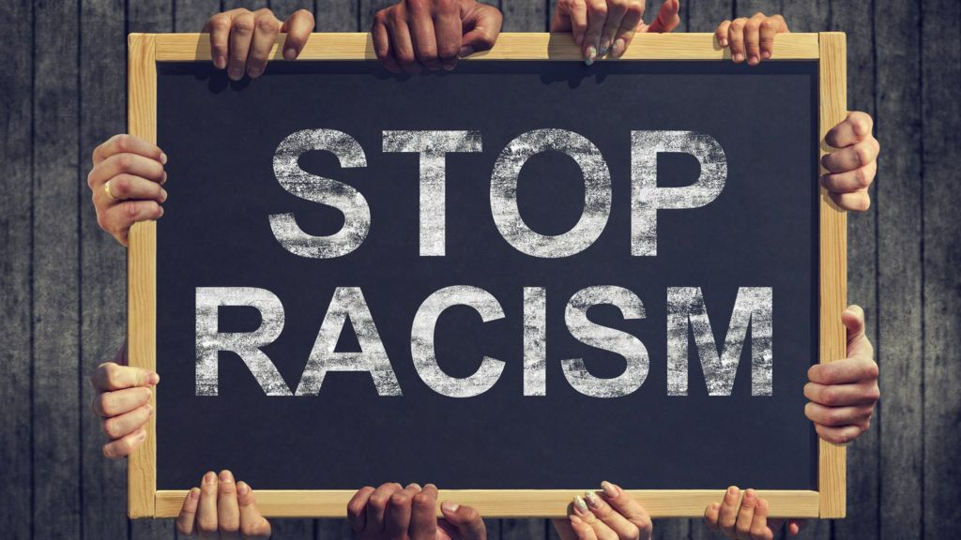
Notes:
I want to remind you of a couple of things we have learned about racism and race in the history of the United States.
Racism is a huge problem in the United States and has been in particular since the country began. Racism is a set of beliefs and practices that reinforce the idea that some humans are more valuable than others on the basis of skin color.

Slide 8
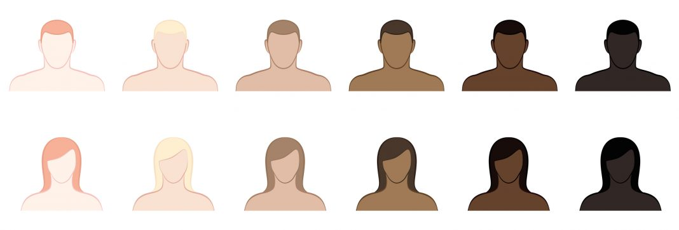
Notes:
Those beliefs and practices are toxic, and they have created a society where people with lighter, whiter skin are considered more valuable than people with darker, blacker skin. In other words, our society is shaped by what we call “racial hierarchy,” a kind of ladder of skin colors and advantages with light/white at the top, dark/black at the bottom, and a range of people in between.
Yes, race was created as a way of categorizing humans largely according to their skin color as if different skin colors actually meant different things – which they didn’t until people in power said they did. Over time, the ideas that people came up with around race shaped people’s lives – from their livelihood to their love life to their families and friendship networks.

Slide 9

Notes:
This pyramid represents a hierarchy. Does anyone know what the word “hierarchy” means?
One way of thinking about Hierarchy is the belief that some people, because of what they look like, are more valuable than others and therefore should be treated that way. In a hierarchy, there is a top and a bottom and spaces in between.
Some people support the idea of racial hierarchy and do everything in their power to make sure that it continues. To justify this hierarchy or to make it seem like this hierarchy was normal and natural, people created all kinds of ideas that would sort of explain racism away – these ideas were racist ideas. Racist ideas tell stories to teach people that lighter, whiter people are better and superior to darker, blacker people. Those stories use stereotypes to distort the truth. Stereotypes are huge generalizations that often take a sliver of truth and makes it the whole truth. Stereotypes sound like “All White people are …” or “All Black people like …” or “All Asian people believe …”

Slide 10
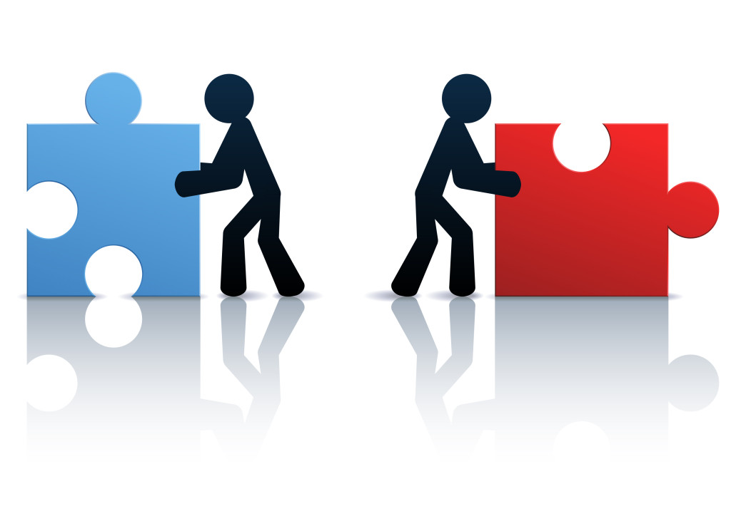
Notes:
Not only do we have a lot of work to do to end racist behaviors and practices that give some people more advantages than others simply because of skin color, we also have to end racist ideas that aim to drive us apart. Racist ideas, what some people call “racial bias,” can divide us and drive us away from each other. Racist ideas can prevent us from having beautiful friendships and relationships with people who are different from us.

Slide 11
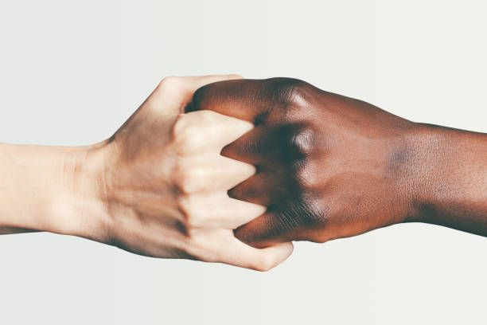
Notes:
In the early days of the American colonies that eventually became the United States, interracial marriage and relationships – marrying people across lines of race – were not outlawed. In some ways, it was normal for people to be together interracially. The more there were people of different backgrounds spending time with each other, the more likely it was that people would want to be with each other across racial lines.
However, as racism picked up steam to justify slavery, those relationships were eventually outlawed in many places until the late 1960s.
The primary interracial relationship that people wanted to prevent was white people and people of color.
Why do you think people in power worked so hard to keep white people and people of color away from each other?
The idea of racial separation has persisted in U.S. history and people have resisted it in different ways.

Slide 12
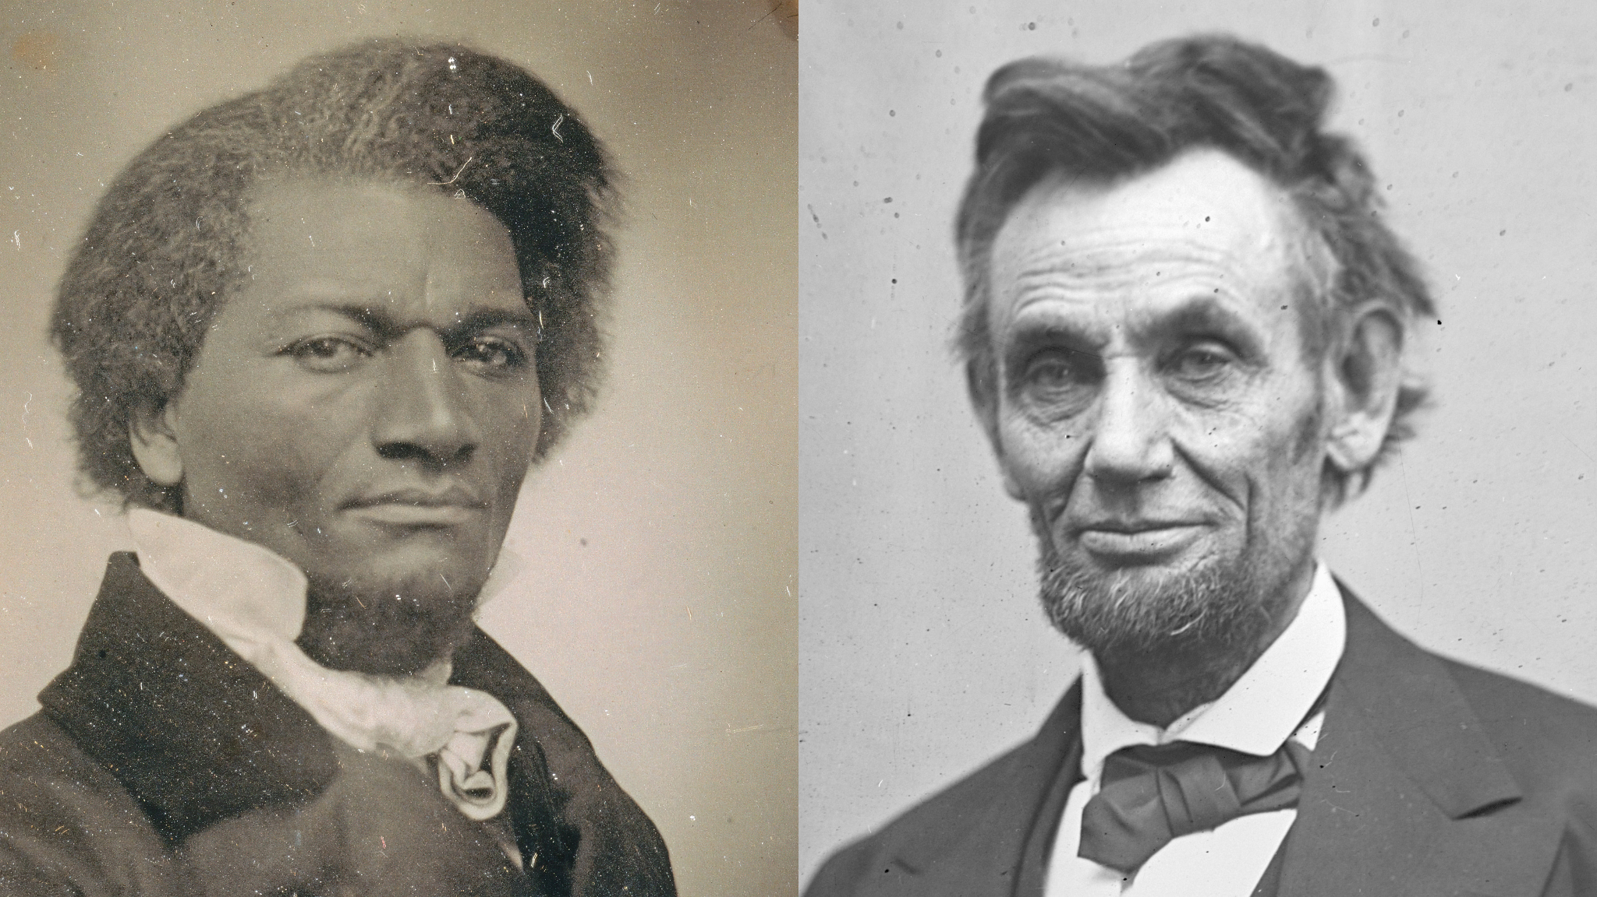
Notes:
Anyone know who these two figures are?
One famous example of an interracial friendship is the one between Abraham Lincoln and Frederick Douglass (Ambar, 2022). They formed a political alliance and interracial friendship, with Douglass helping Lincoln to inform those enslaved in the South that the Emancipation Proclamation would grant their freedom.

Slide 13
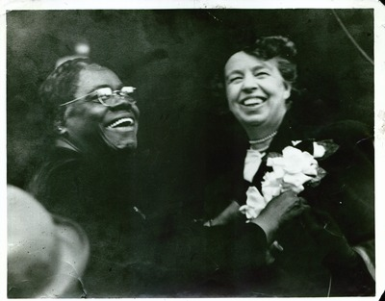
Notes:
Anyone know who these two figures are?
Another well-known example is the interracial friendship between Mary McCleod Bethune and Eleanor Roosevelt. Bethune’s relationship with Roosevelt gave her significant power and influence as the first black woman to serve as an advisor to the president. Together they worked on many efforts to advance the position of Black Americans and served as a symbol of what was possible on a national level.

Slide 14
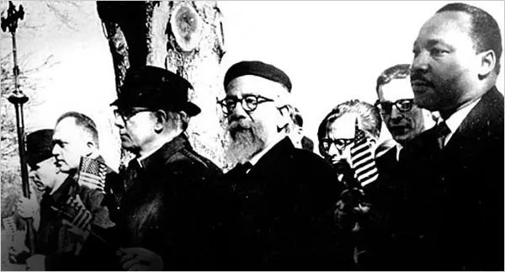
Notes:
Anyone know who these two figures are?
The interracial friendship between Rabbi Abraham Joshua Heschel and Rev. Dr Martin Luther King Jr is also an excellent example of a famous interracial friendship (Ambar, 2022). They had a strong moral sense of justice in common. They got to know each other at the Chicago Conference on Religion and Race in 1963. Their friendship was exemplified during the Selma march in 1965 and King’s Riverside speech condemning the Vietnam War in 1967. Their bond drew attention to moral courage in the face of profound injustice and overcame historical tensions in Black-Jewish relations.
Yet interracial friendships, despite their rich history, continue to be unique. Let’s fast forward to today.

Slide 15
Important Data Points
  Polling data reported in the Washington Post suggests that 75% of whites have no non-white friends whatsoever.
  83% of people in black Americans’ social networks are black.
  64% of people in Hispanic Americans’ social networks are Hispanic.
  54% of Asians have reported that all or most of their close friends are Asians.
  Only 17% of couples in the US are interracial.
Notes:
Review these data points.
Why do you think there is still so much racial separation and why are interracial friendships and relationships rare in some parts of the country?
What kinds of stories get in the way?
In this next clip, we will hear from young people who have experienced positives and negatives while navigating cross-racial friendships.
Citations:
Fania Davis, Race and Restorative Justice, 33.
Ijeoma Oluo, So You Want to Talk about Race, 86, 94.
Crystal Fleming, How to be Less Stupid About Race, 174.
Deborah Plummer, Some of My Friends Are …, 25, 43.
Dasgupta, 2004; Dasgupta, 2008)

Slide 16
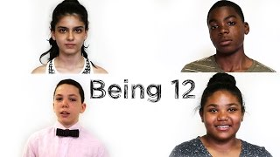

Slide 17
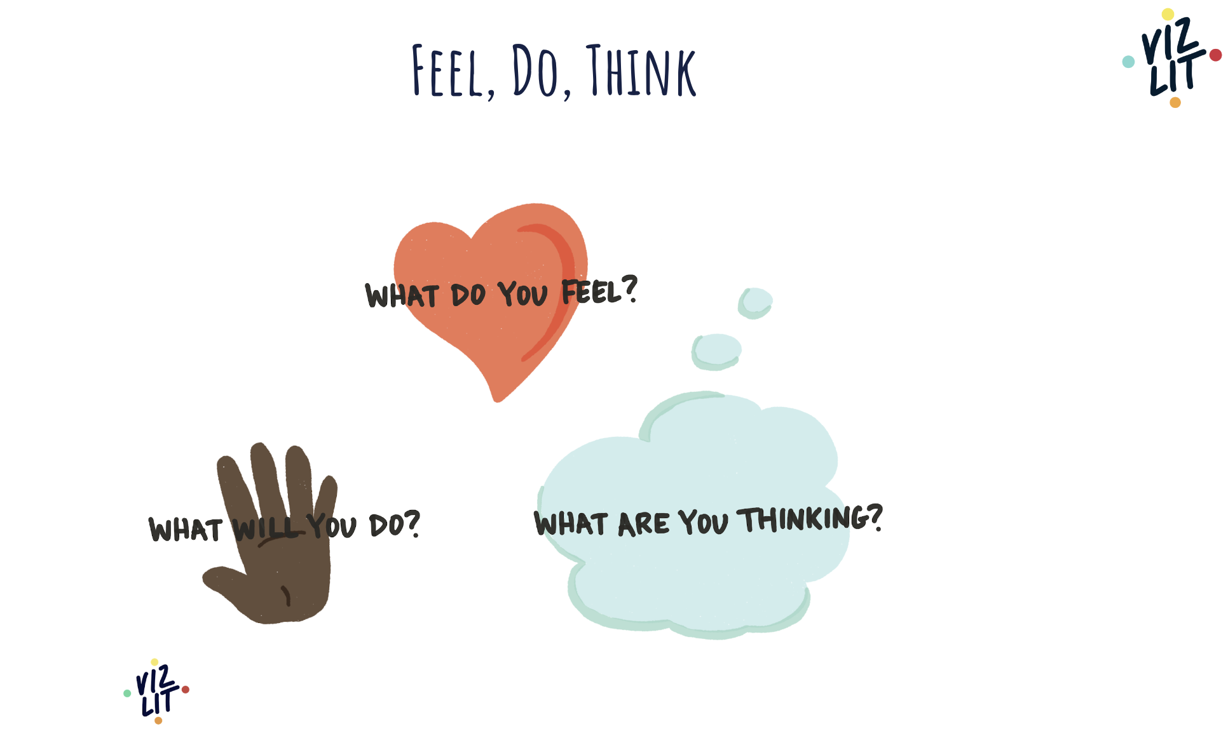
Notes:
Ask students now to complete this reflection chart based on the video they watched.
Ask for several volunteers to share what they wrote under that last column.

Slide 18
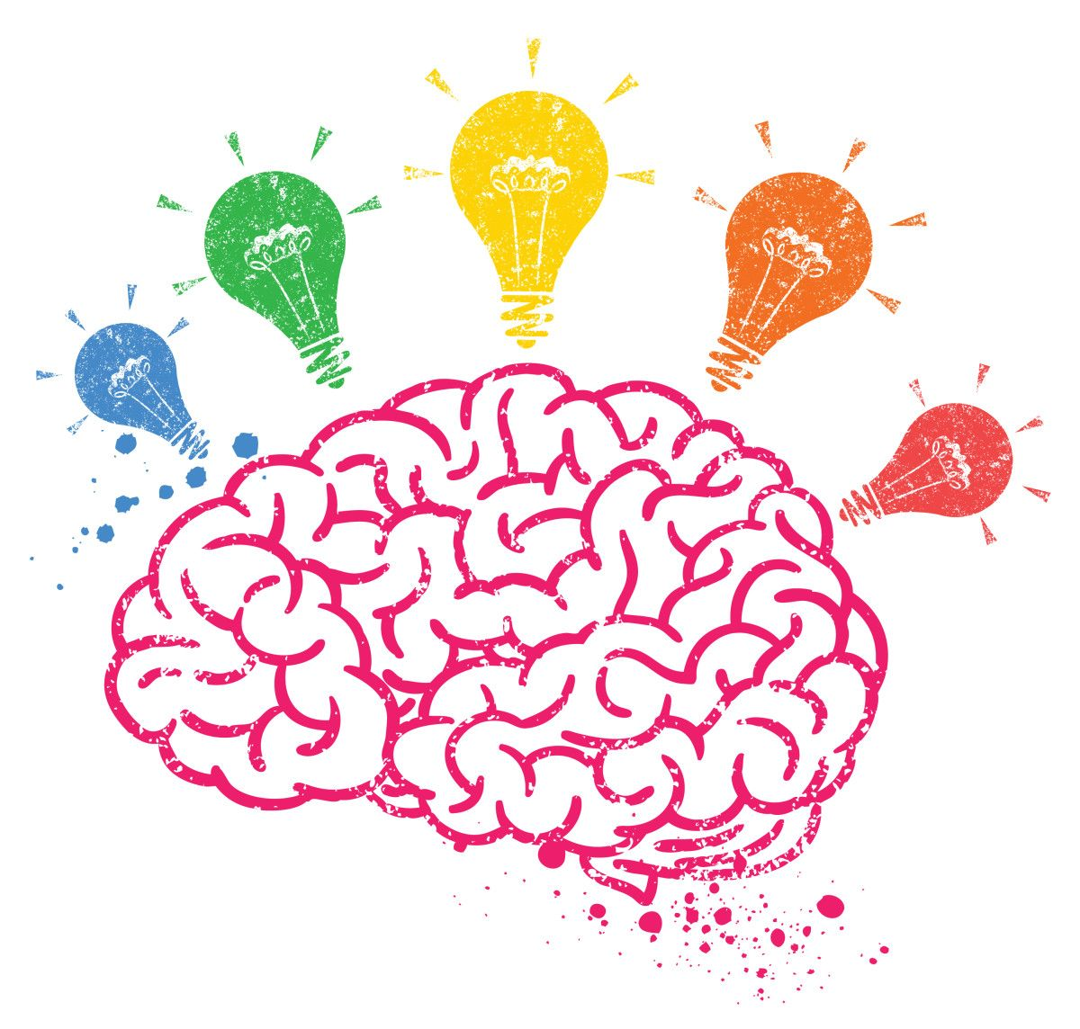
Notes:
Let’s spend time thinking about what makes interracial friendships work well – given all of what we have learned.
What makes interracial friendships work?
Examples:
Being honest about our experiences
Listening thoughtfully to one another
Being aware of different lived experiences
Being upstanders

Slide 19
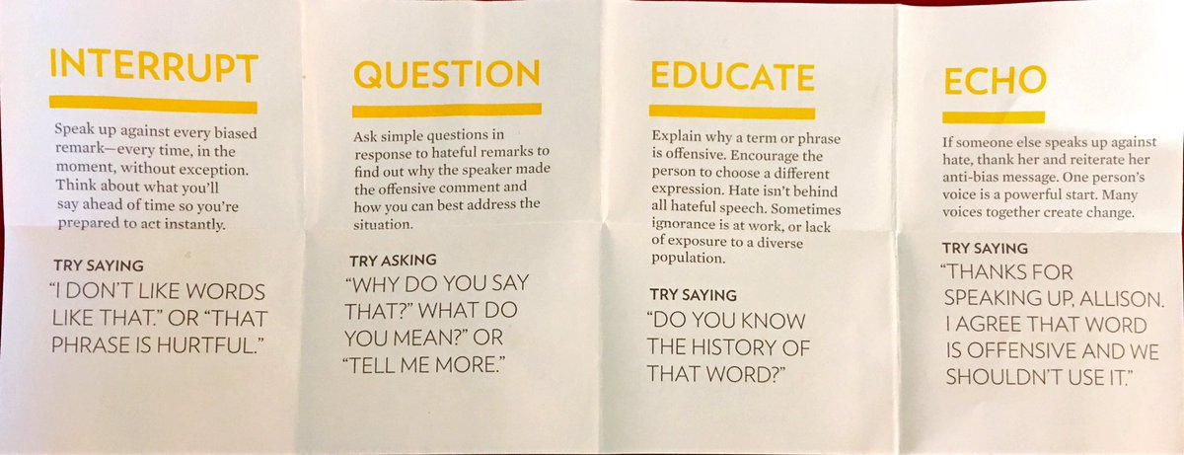
Notes:
Let’s end by talking about upstander strategies. Review the information on the slide.
Can you imagine a situation where you are faced with someone saying offensive things about interracial friendship or relationship -– perhaps about your interracial friendship. What could you say in response? What are your options?
What are your takeaways from today’s class?
Remind students that they always have options in challenging moments like these.
Citation: https://www.learningforjustice.org/sites/default/files/general/speak_up_pocket_card_2up.pdf

Slide 20
Extended Learning for Educators
Navigating Tricky Comments
SCENARIO

Slide 21
Scenario
A student says
“My grandparents wouldn’t like it if I married someone of another race. They’d probably kick me out of the family.”
SOME STRATEGIES WE COULD CONSIDER:
It is not unusual for students to have more inclusive ideas and experiences than their parents/guardians and grandparents. The dissonance between a student’s school life and their home life can be profound and really hard to reconcile. In moments when students give voice to that dissonance it is important to demonstrate gratitude for their openness and vulnerability, normalize the experience of the dissonance, avoid demonizing their family, and affirm their emergent commitment to the values of dignity and inclusivity.
Offer gratitude and affirmation.
“Thank you so much for being so open with us and sharing a bit more about how hard it may be to have a relative who does not value inclusion like we do here?”
“It is normal to have big feelings about having relatives who may not share the same values as we do. It is important, though, that we make decisions for ourselves not based on their values, but on our own.”
Affirm their commitment to dignity and inclusivity.
“Just because our relatives may at times have harmful and biased views, we do not need to carry those views forward. We can choose the path of dignity and inclusivity for all.”
“It can be hard to know what to do or say in a moment when someone expresses a biased viewpoint. Would it be helpful for us to brainstorm ways of responding to our relatives if and when they say things that are biased or hateful?”

Slide 22
Email: info@pollyanna-us.org
Website: www.pollyanna-us.org
SOCIAL MEDIA
Facebook / Instagram: @us_pollyanna
LinkedIn: Pollyanna-us

Slide 23


