Slide 1

From Around the World––Lessons from Changemakers on What Makes a Great Society
Grade 4 / Lesson 9
UNIT: The Development of Civilization––How Geography Gave Some Populations a Head Start
Notes:
Gather students in a circle for the lesson in front of the projected slides.

Slide 2

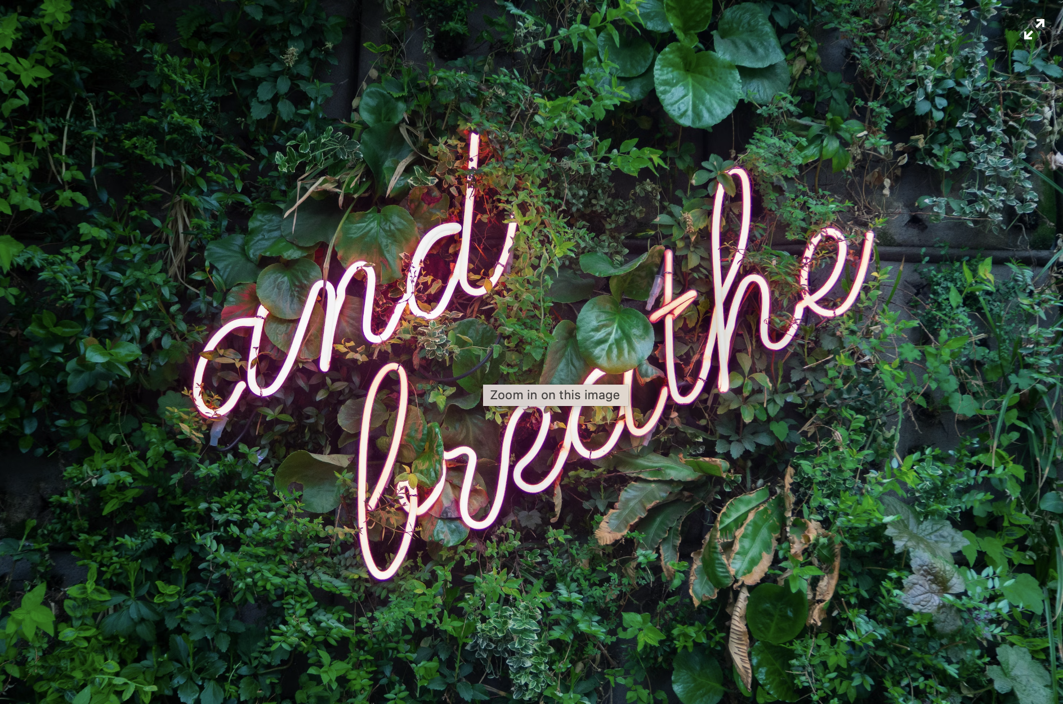
Photo by Max van den Oetelaar on Unsplash
Notes:
Invite students to wiggle their bodies into a comfortable position and then lead them through a simple breathing or mindfulness exercise.
Examples:
1-minute of mindful breathing
(fake) Yawn & 10 second stretch - notice and “greet” any tension or tightness
Self-Love Hug w/ 3 deep breaths
Hand stroke - with eyes cast or closed, using index finger of one hand, gently trace the outside of all fingers on the opposite hand, then switch hands
full body scan - noticing any tension, sensations, or emotions in different parts of the body
Remind students that slowing down to breath in this ways helps us to stay calm and focused.

Slide 3
What makes a human society great?
What makes a human society not-so-great?
Notes:
Students, today we are going to talk about the characteristics of a great society according to changemakers from around the world.
Some societies have been celebrated for not-so-good reasons while other societies that have done great things have been downplayed. Furthermore, some people have misidentified the characteristics that make a society truly great.
Most, if not all, humans belong to a society, which is a large group of people who have a particular way of living together – or an “order” of how they do things together.
All human societies have their shortcomings, where they are not good at promoting what is best for a variety of people.
Let’s brainstorm together what comes to mind on two important questions:
What makes a human society great?
What makes a human society not-so-great?
Now let’s turn our attention to ideas from changemakers from around the world

Slide 4
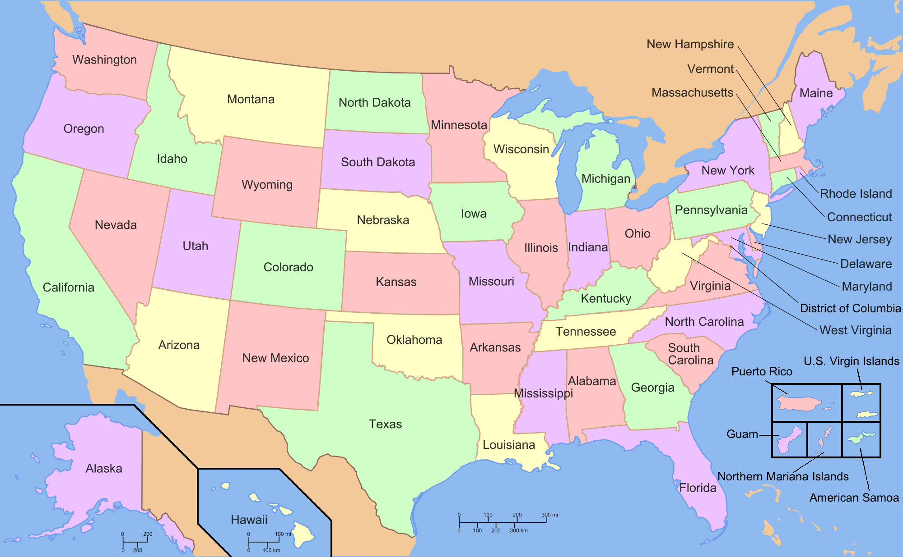
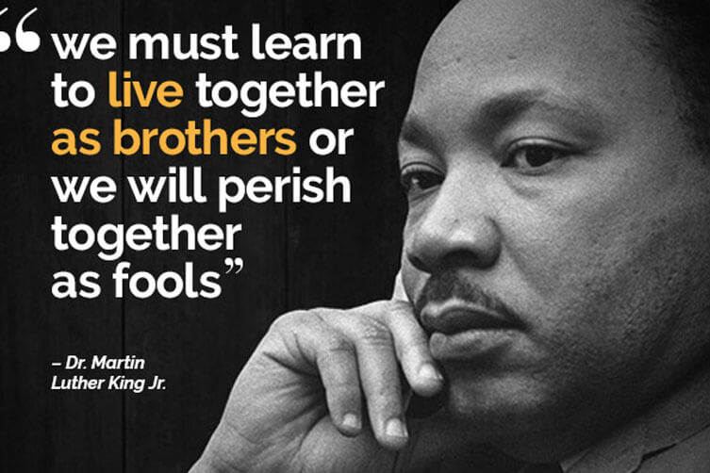
Notes:
A famous changemaker here in the United States once made this statement.
Read the quotation.
Can anyone guess who it was?

Slide 5
Notes:
Dr. Martin Luther King, Jr. was a Black Baptist preacher and changemaker who spent much of his life during the 1950s and 1960s pushing for civil rights for Black people in the United States.
What do you think Dr. King meant when he made this statement?
Can anyone think of examples that illustrate Dr. King’s point?
In his own time, Dr. King saw hatred tear people apart and make society far more dangerous. He wanted people to learn to embrace each other across differences as if they were members of the same family.
Based on this quote, why do you think Dr. King was such a fierce opponent of war?

Slide 6
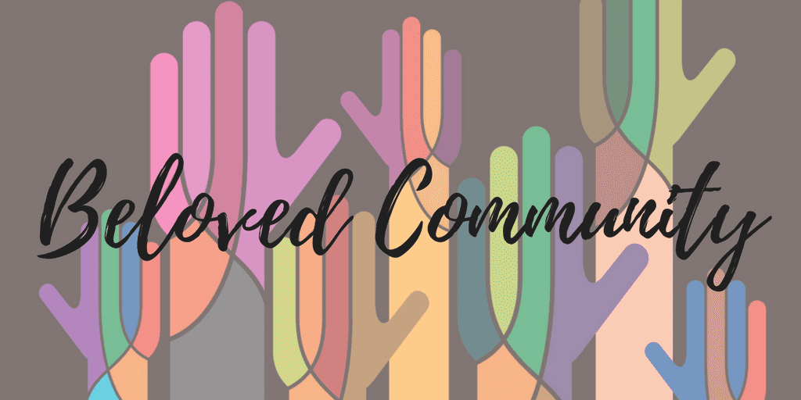
Notes:
Dr. King had strong feelings about the need to create a society where there was no more poverty and no more racism and mistreatment of people on the basis of skin color. He wanted a society where everyone had what they needed to flourish and survive. He wanted a society without hate and without neglect. When people need help, it should be available to them. When people need support, it should be there for them. Dr. King believed that all humans should be treated fairly and respectfully regardless of their color or how much money they had or didn’t have. For Dr. King this was a true beloved community. A society that cares about people who are poor is a great society. A society that tries to stop poverty and also racism is a great society.

Slide 7
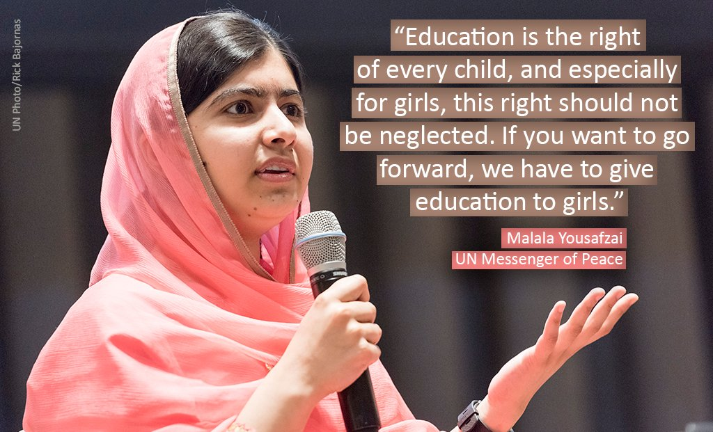
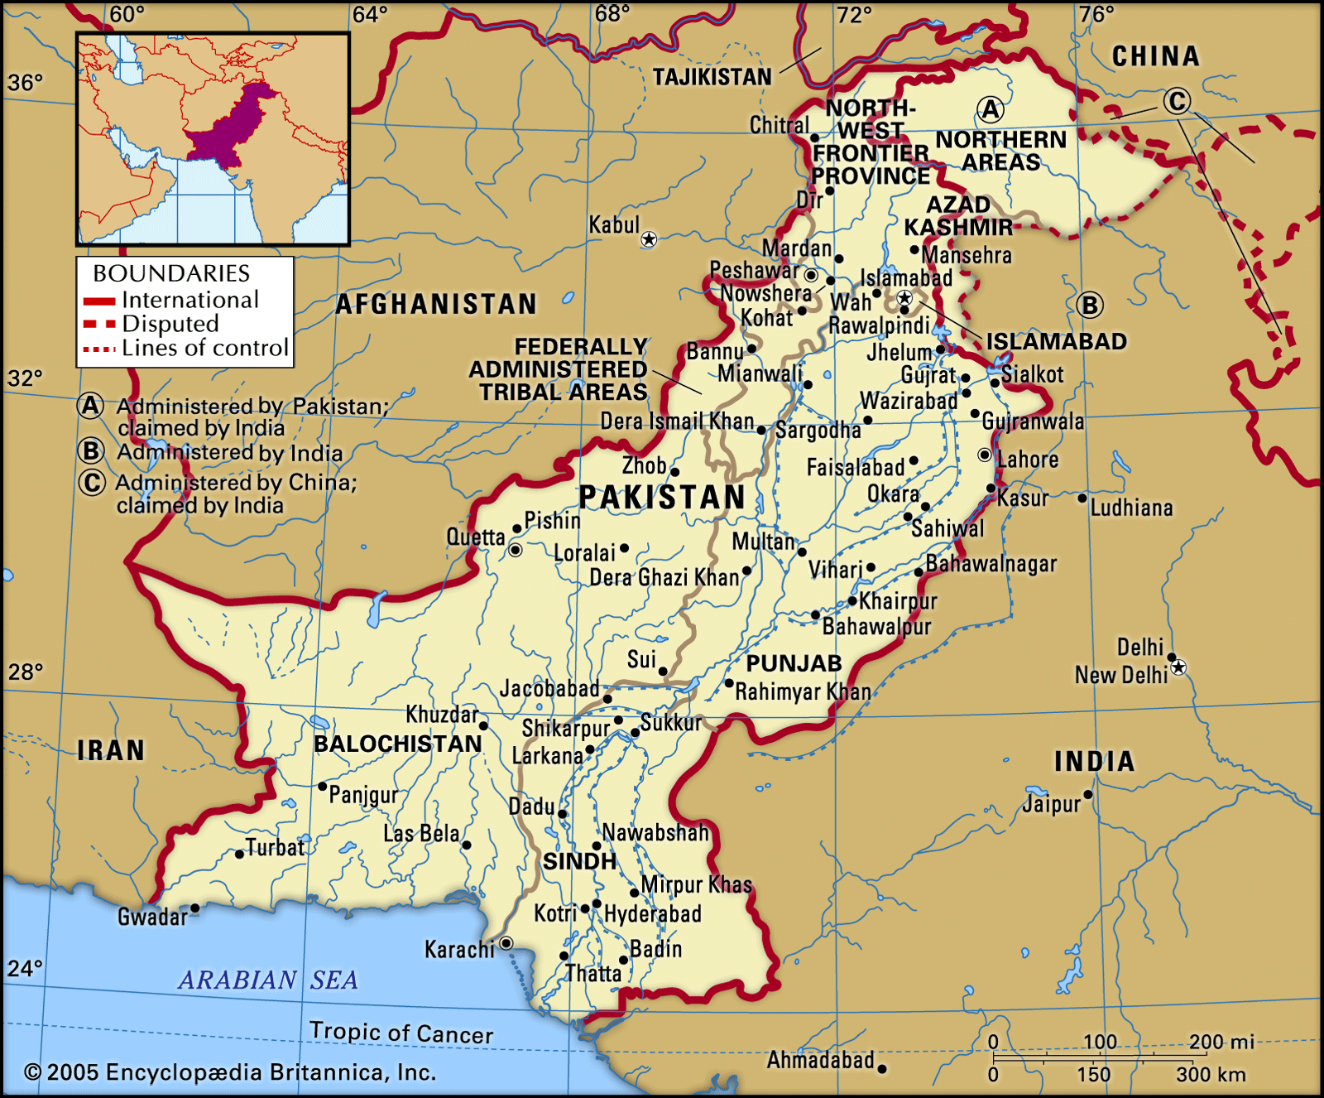
Notes:
A famous changemaker not from the United States once said this very quotation.
Read the quotation.
Can anyone guess which changemaker said this quote? A hint: She is from the country of Pakistan.And you may have learned about her last year.

Slide 8
Notes:
This quote comes from Malala Yousafzai, a changemaker from Pakistan who took a stand in her country for the human right to education.
What do you think this quote means?
In her country of Pakistan, Malala encountered people in power who did not believe that girls should go to school. These people said that girls belonged at home and should be doing things they thought was better for girls and women to do. These people had stereotypes about girls and boys – really unhelpful ideas that separated people into boxes.
Why is education so important?

Slide 9
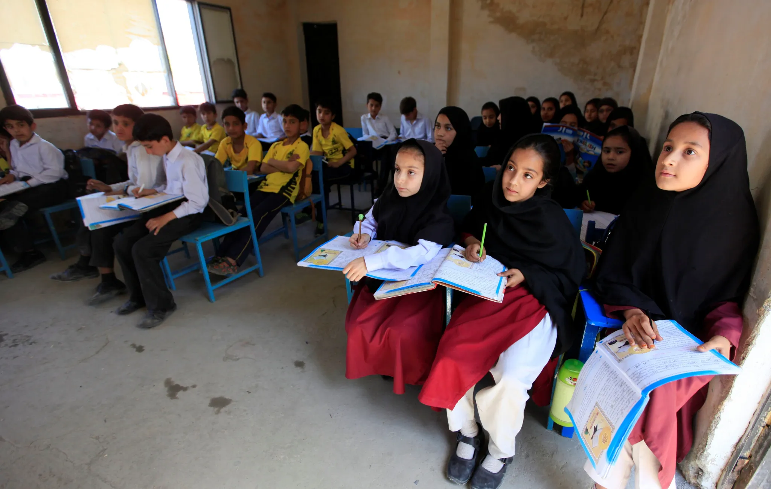
Notes:
In 2008, a rebel group took charge of Malala’s village in Pakistan. They said that girls could no longer go to school and had to stay at home. Malala had to say goodbye to all of her classmates. She was so hurt and upset. The rebel group began spreading fake information around the country. Years later she began to speak out against the unfairness of not allowing girls to go to school. The rebel group searched for her and shot her. She was flown to the UK for surgery and to recover. It was a terrible situation. But, it did not stop Malala from speaking out and creating change. She has been an advocate around the world for education for everyone! The more that people know the less likely they are to be controlled by others or to believe fake information. Education for call can make a society great.

Slide 10
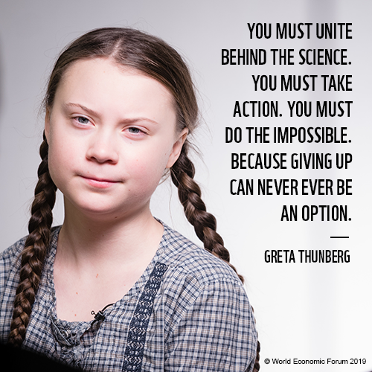
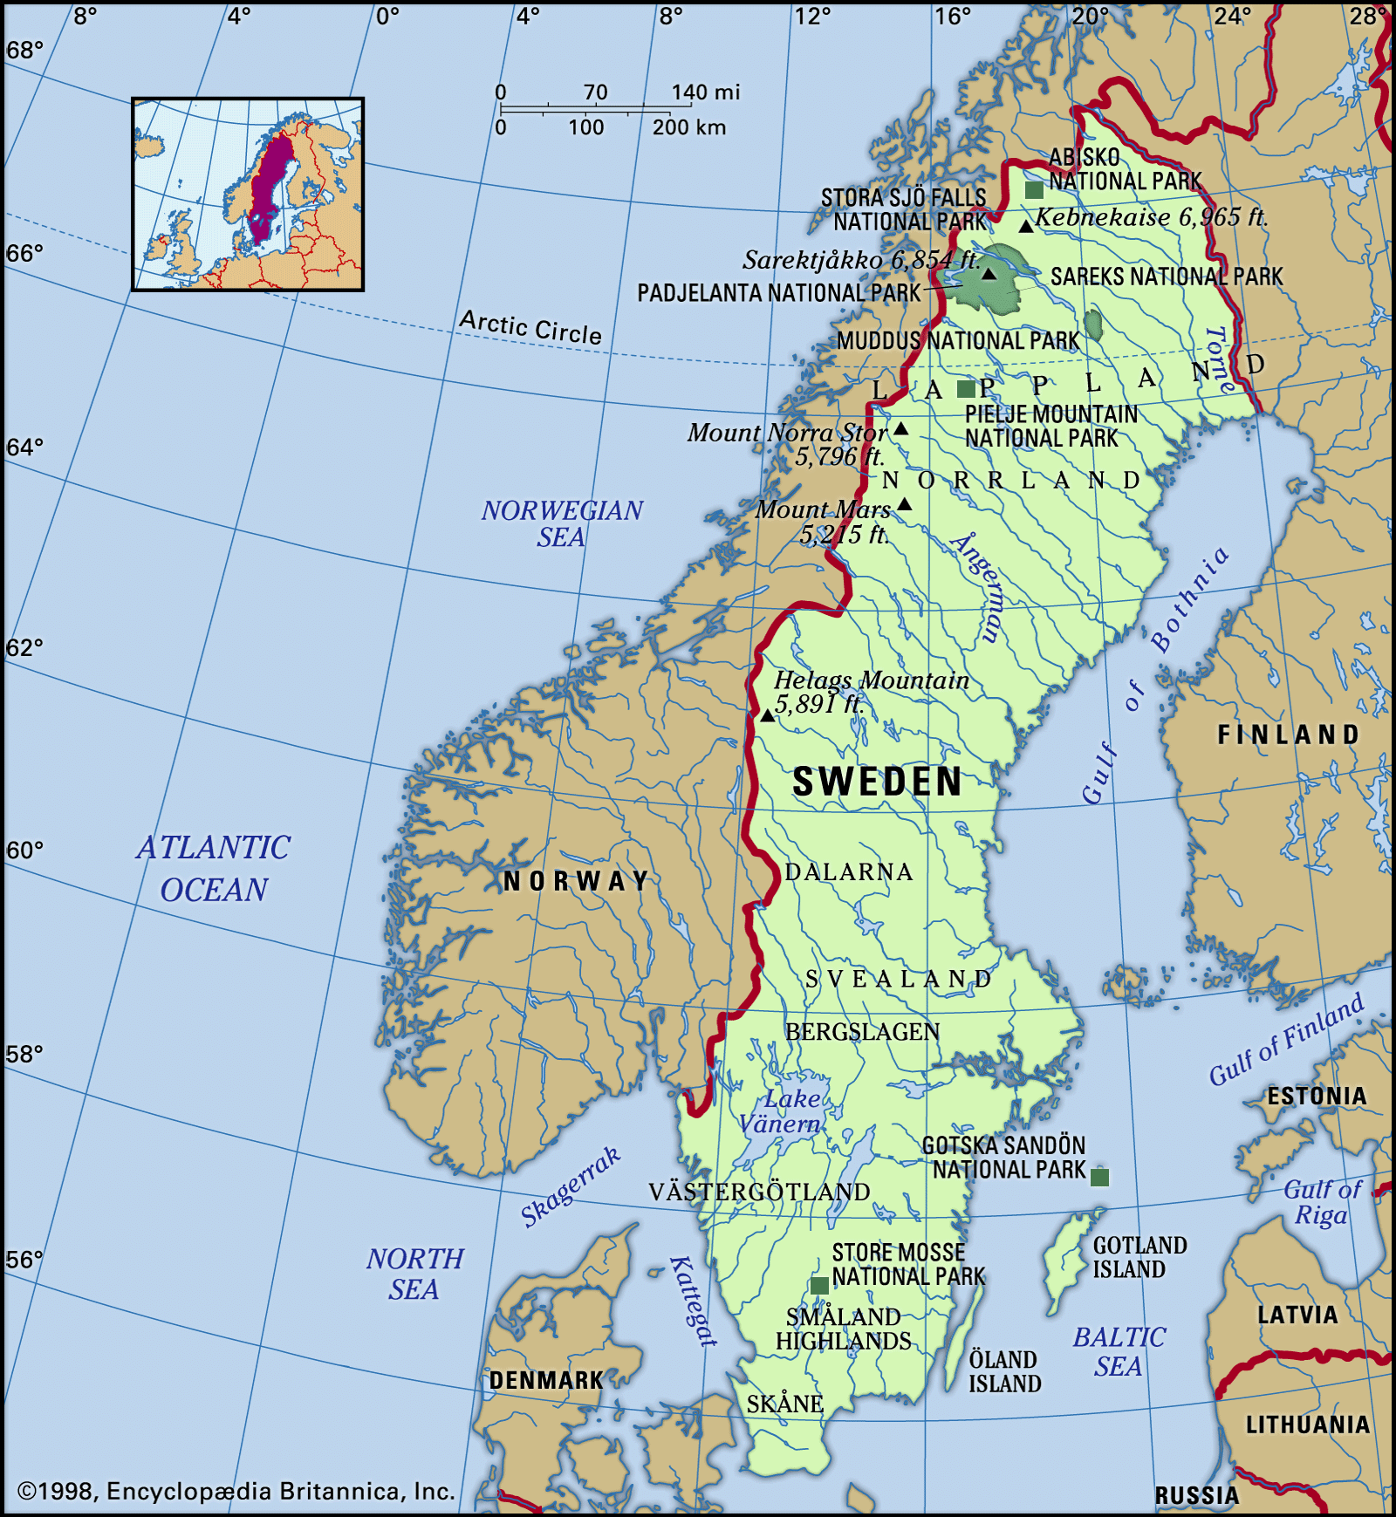
Notes:
A famous changemaker not from the United States once said this very quotation.
Read the quotation.
Can anyone guess which changemaker said this quote? A hint: She is from the country of Sweden and cares deeply about the planet.

Slide 11
Notes:
This quote comes Greta Thunberg, who is now 21 years old, but she got her start much younger as a changemaker in Sweden who has been educating people about the negative impact that humans have had on the climate and the planet. She has argued for people to take action to treat the planet better. She has asked leaders of countries and big companies to work harder to protect the planet.
What do you think this quote means?

Slide 12
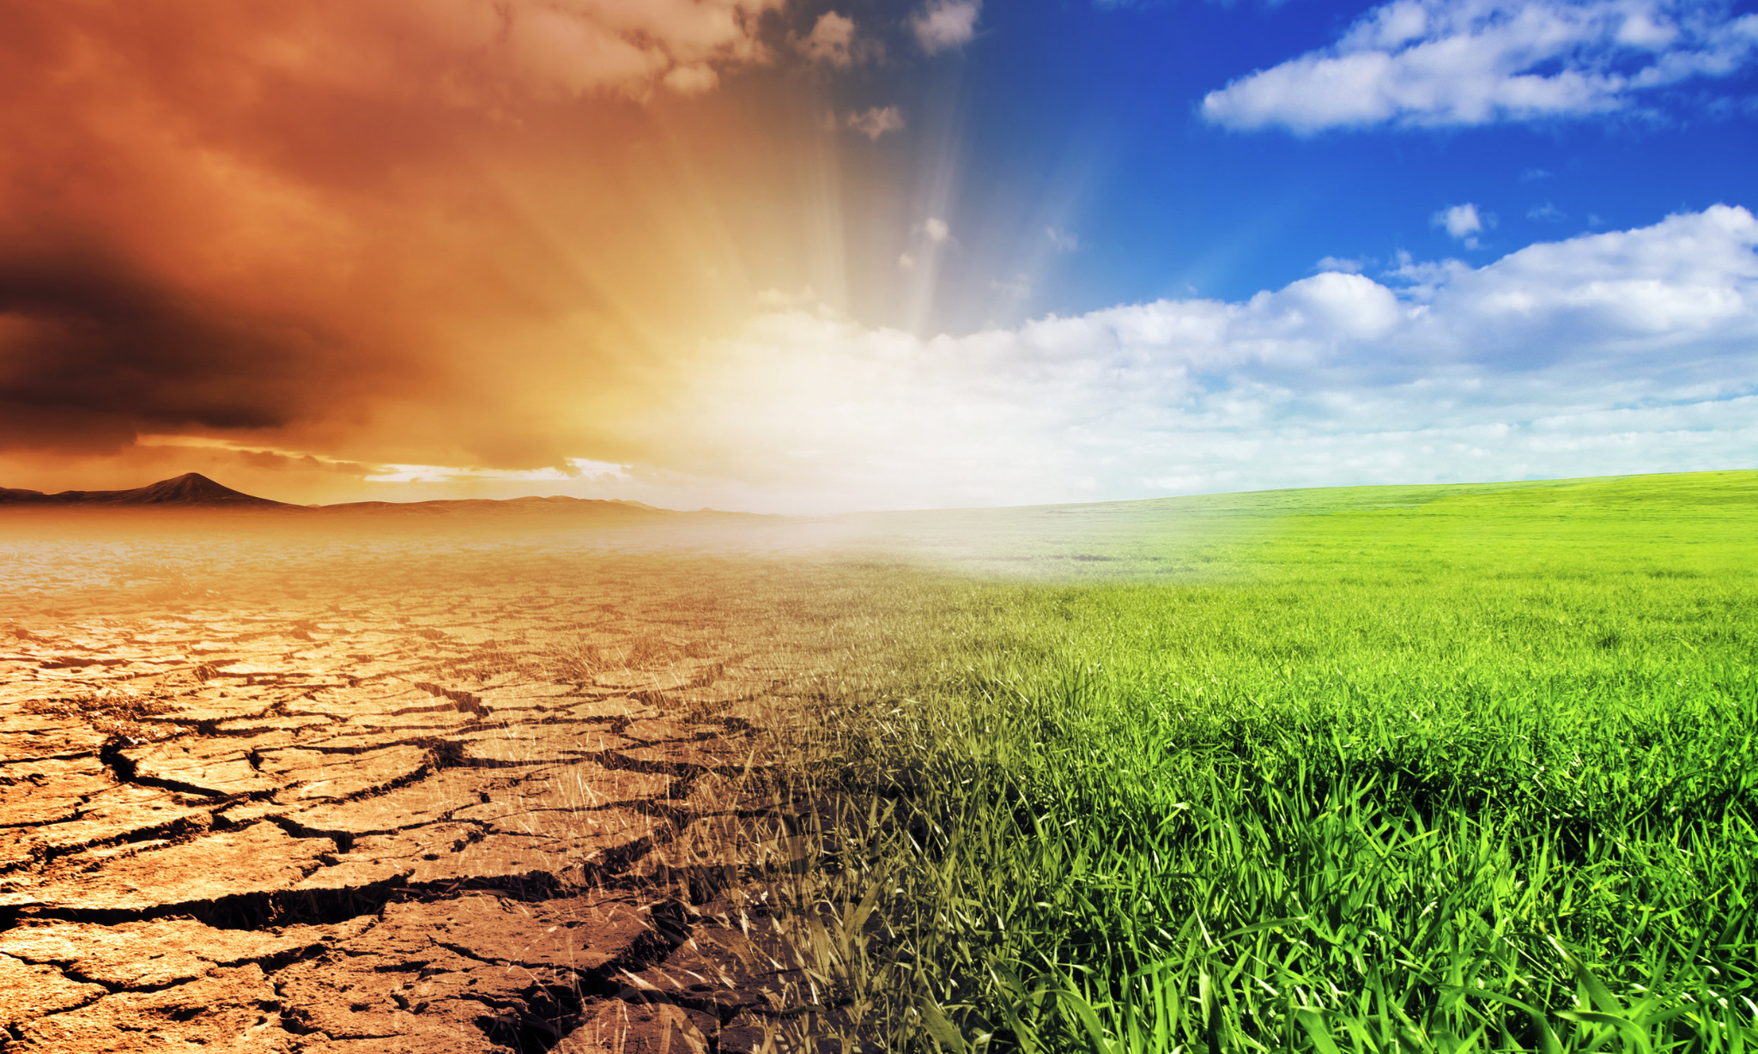
Notes:
Many big companies and governments burn fossil fuels for electricity, heat, and transportation. Burning fossil fuels hurts the planet. Greta is pushing for new ways to provide electricity, heat, and transportation. She is also pushing for leaders to acknowledge the truth that they have not cared enough about the planet and have not worked hard enough to protect it from fossil fuels. Science is showing us what happens to our planet when we don’t take care of it. Greta argues that we must take action to care for the planet and for the humans and other species who depend on it. She tells us we cant give up and have to push people to do what is right. For Greta, a great society is one where we care for the planet and one where we take action on what we believe in.

Slide 13
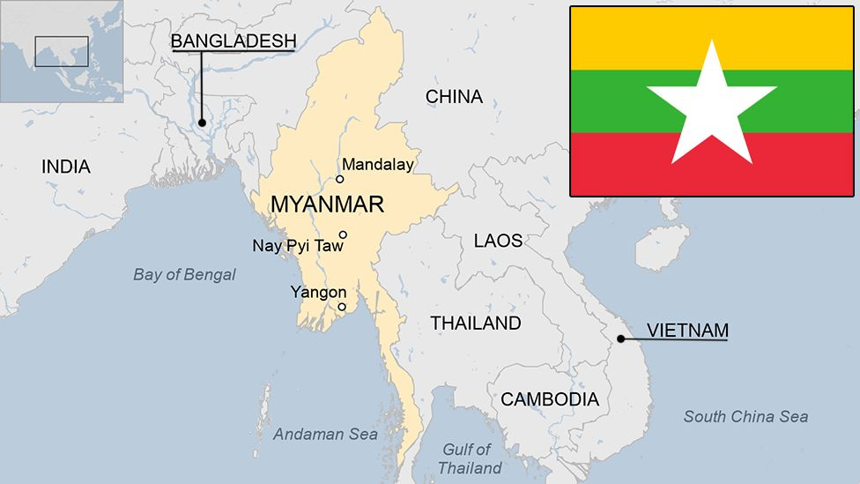
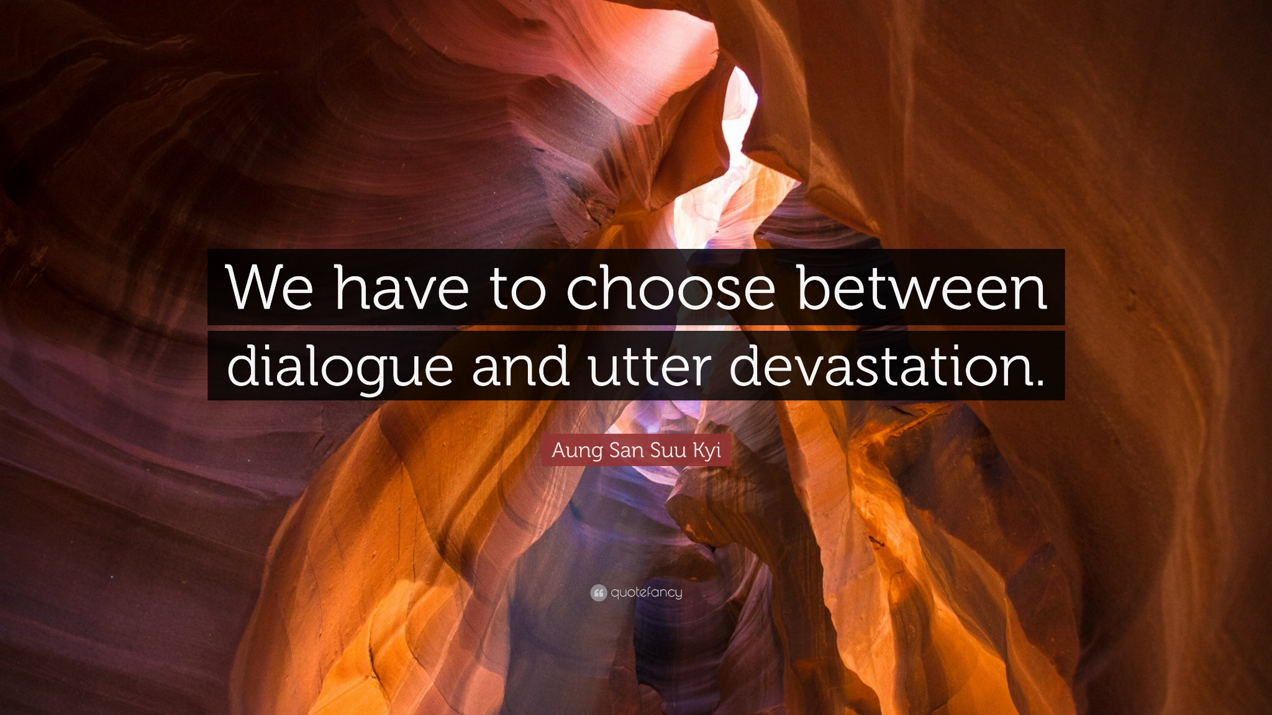
Notes:
A famous changemaker not from the United States once said this very quotation.
Read the quotation.
Can anyone guess which changemaker said this quote? A hint: She is from the country of Myanmar.

Slide 14
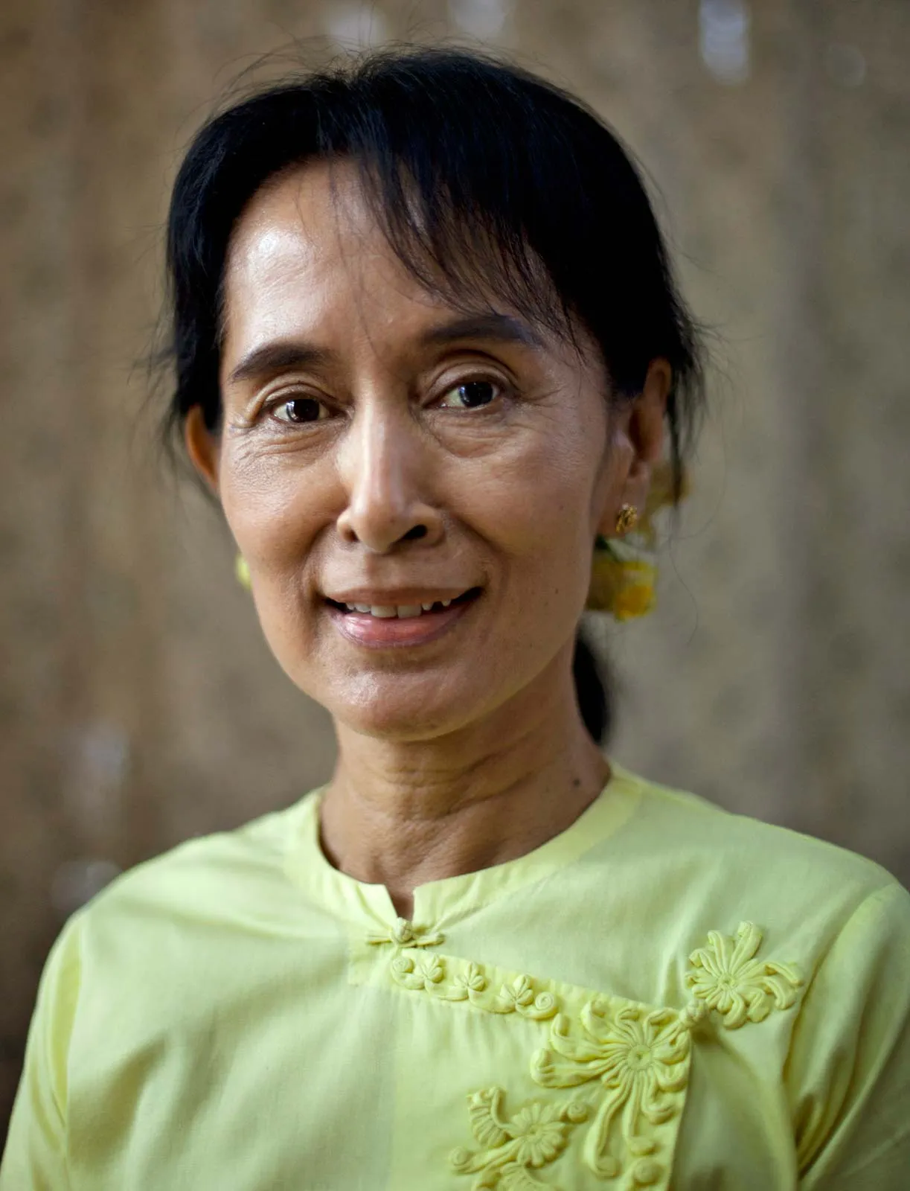
Notes:
This quote comes from Aung Saan Su Kyi, who was once upon a time a political leader in the country of Myanmar, formerly known as Burma. She worked hard to rid her country of rebel groups and military that took over the country and denied everyday people’s right to elect a leader. The rebel groups and military had refused to talk with her and with others. Yet she protested and spoke out until things changed. She repeatedly invited her enemies to have a conversation and to try to create change together.
What do you think this quote means?

Slide 15
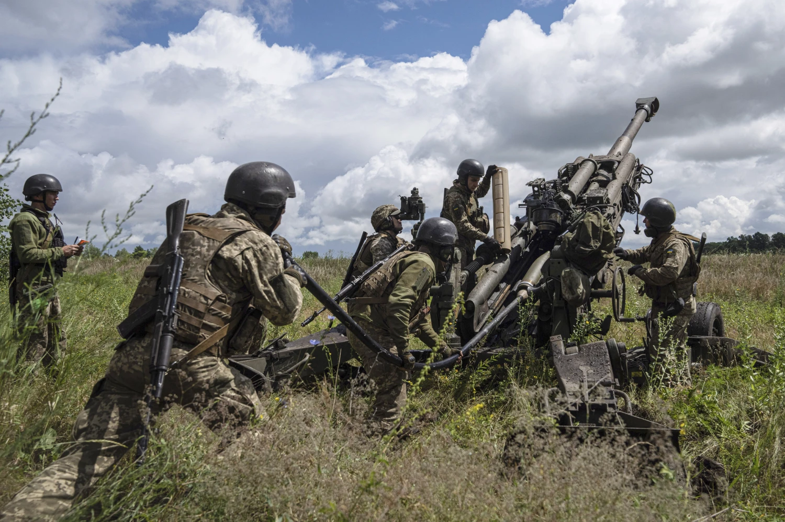
Notes:
Without dialogue, horrible things can happen. Aung Saan Su Kyi had strong feelings about war and violence. She was very worried that people in power would ignore those who are not in power and would take over her country and other countries. She rejected war. Su Kyi wanted people to find nonviolent ways of working through their disagreements. She saw ways that violence and would tear societies apart and would devastate human families. She pushed for the idea that we should all be in dialogue with one another. A truly greater society would be one of more dialogue and less violence, is a great society.
Something else to note is that Aung Saan Su Kyi has faced criticism in recent times because people have felt that she did not live her own values. Some have argued that when she was given a chance to govern, she was not kind to Rohingya Muslims who were a minority population in her country. Even great changemakers can make real mistakes.

Slide 16

Education
No hate, no racism, no poverty
Practice dialogue
Care for the planet
Notes:
These are four things that we have heard from changemakers on what can make a society great. Let’s review.
If you had to add a fifth idea to this list that you could create on your own, what would it be?
Take out a piece of paper and journal in response to that prompt.
After some time, ask a few volunteers to share some of their ideas.

Slide 17
Extended Learning for Educators
Navigating Tricky Comments
SCENARIO

Slide 18
Scenario
A student says “All of this stuff seems so sad. It’s like our world is broken.”
SOME STRATEGIES WE COULD CONSIDER:
Studying human history is a complex endeavor. We encounter beautiful stories and ugly ones too. We hear about human cruelty and egregious acts of harm. We also hear about human compassion and the capacity for resilience. While studying hard history, it is important to remind ourselves and students about the beautiful elements, times when humans survived against the odds or make differences that had been unimaginable for some. Reminding students of their agency to make a positive difference is critical.
Affirm how hard studying history can be.
“We are studying some hard things that humans have done to each other. It is okay to have big feelings about that.”
“This stuff is hard–and I thank you for naming that. Humans have not always been kind to each other, and that breaks my heart too.”
Reaffirm hope, agency, and positivity.
“Yet, we also have to remind ourselves of the incredible changemakers who have made a real difference in our world. They give us hope that we, too, can make a difference.”
“At the same time, I want to remind us all of the incredible positive changes that have happened in our world because everyday people choose to speak up. Change is possible, and that should give us hope!”

Slide 19
Email: info@pollyanna-us.org
Website: www.pollyanna-us.org
SOCIAL MEDIA
Facebook / Instagram: @us_pollyanna
LinkedIn: Pollyanna-us

Slide 20


