Slide 1

Why Do We March?
Grade 3 / Lesson 9
UNIT: Stories of Activism – How One Voice Can Change a Community (and Bridge the World)

Slide 2

Agenda
  Lesson objective
  Invitations
  Why do People March?
  Vocabulary
  Read Aloud: “Sometimes People March”
  Dialogue on what social issues we care about
  Activity: Art as Activism
  Closing

Slide 3
Objectives
  An introduction to activism and ways individuals can work together as collectives to express their beliefs and advocate for change.
  Explore common reasons why individuals choose to march.

Slide 4
Invitations
  Be fully present
  Have an open mind and heart
  Be curious
  Be willing to share
  Be open to reflect
  Listen respectfully

Slide 5
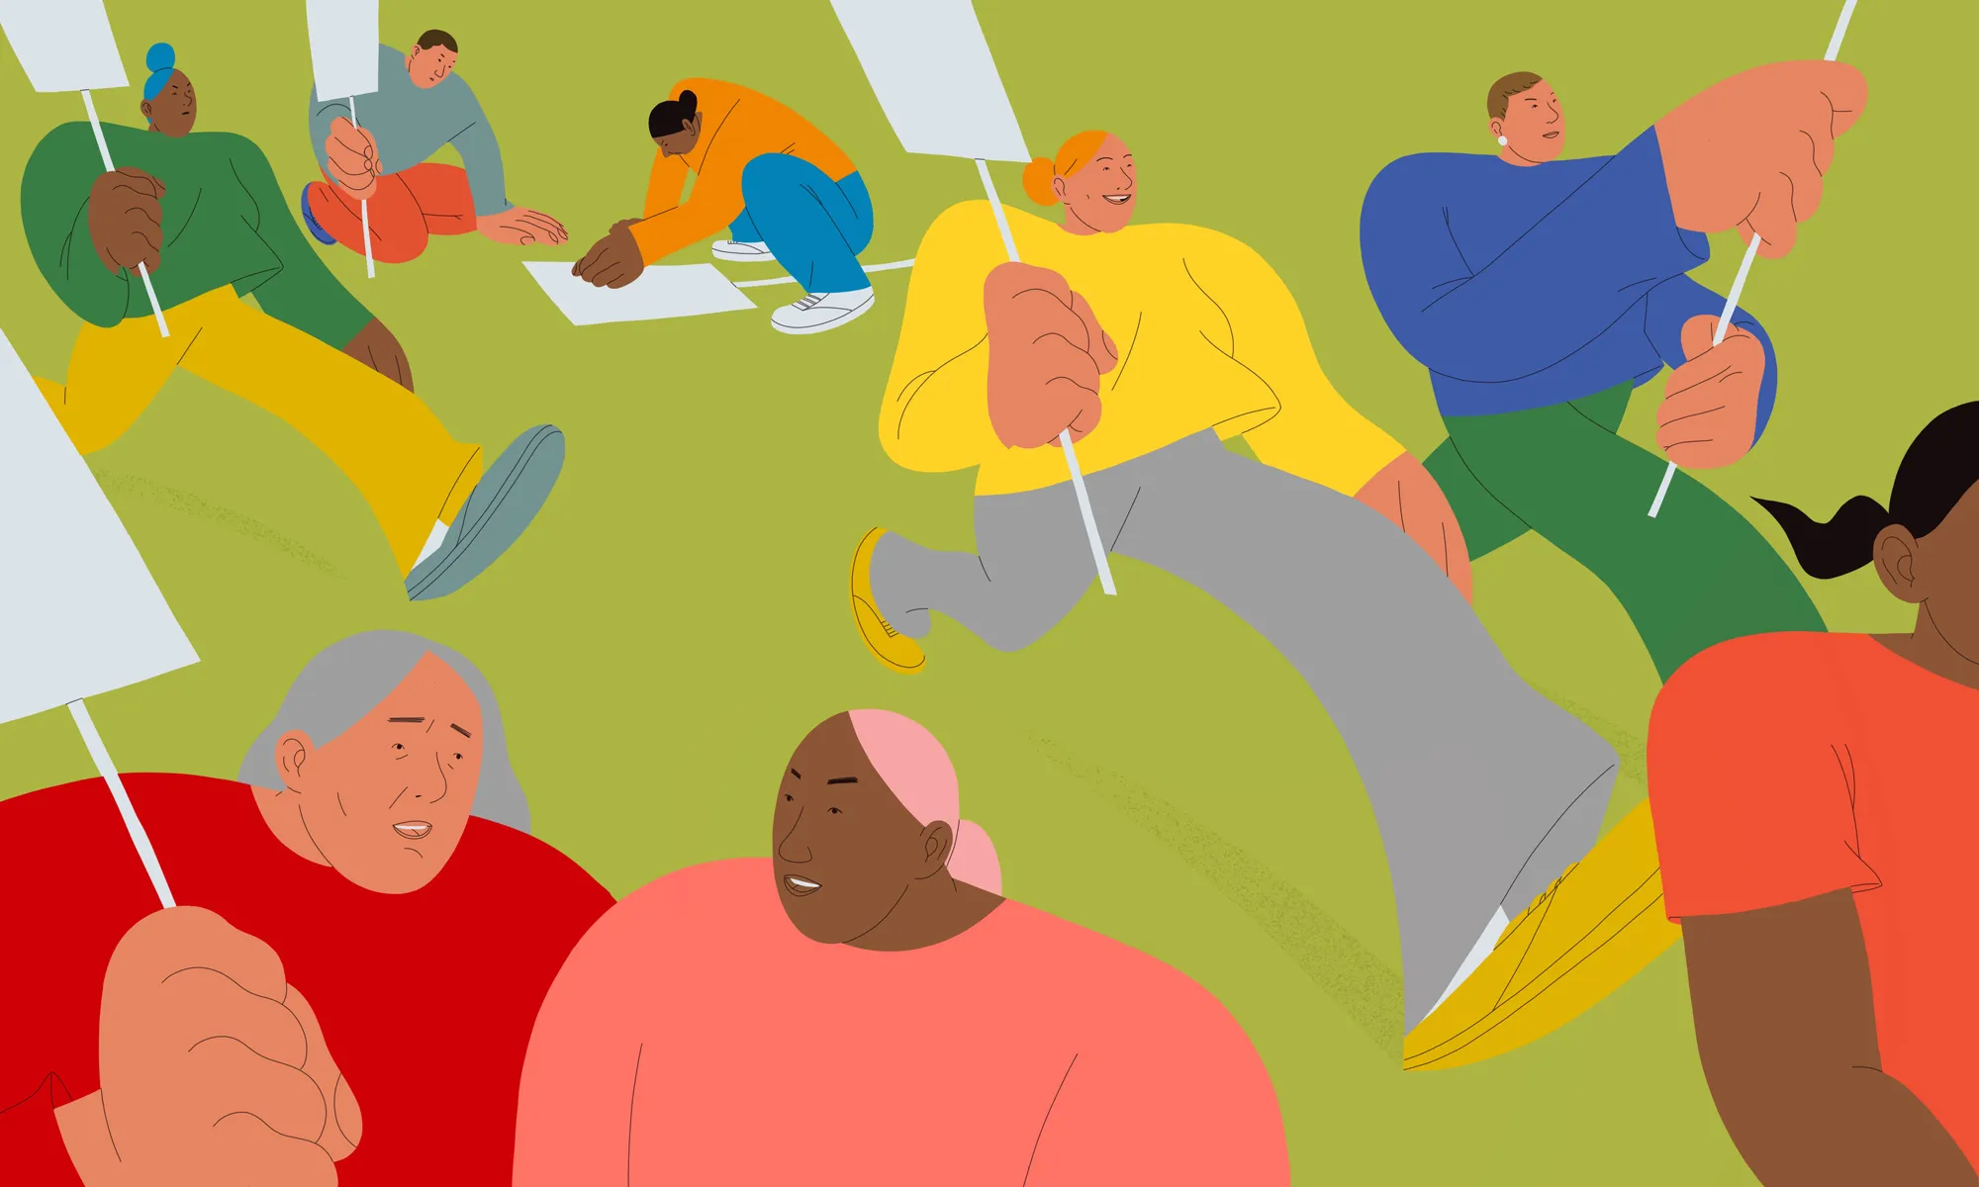
Why Do People March?
Marching is a peaceful form of activism.
People march as a way to resist injustice and stand up for social issues they care about.

Slide 6

Vocabulary
Activism is
Action to make a change, or stop a change, in society.
Injustice is
A situation in which the rights of a person or a group of people are ignored, disrespected or discriminated against.
A social issue is
A problem that affects many people within a society.
Notes:
Activism is action to make a change, or stop a change, in society. It can be trying to make a government change its laws, or trying to make people change what they do. There are many forms of activism. https://kids.kiddle.co/Activism
Injustice is a situation in which the rights of a person or a group of people are ignored, disrespected or discriminated against. https://www.adl.org/resources/tools-and-strategies/definitions-related-bias-injustice-and-bullying
A social issue is a problem that affects many people within a society.
Some examples are:
Climate change
Racism
Homelessness
Animal rights

Slide 7

Activity 1:
Real Aloud
Notes:
Read: Sometimes People March by Tessa Allen

Slide 8
Let’s Discuss!
Notes:
Guiding Questions for Students:
Let’s look at some of the pictures in the book, what do you notice? Some of these illustrations are inspired by real life marches and protests in history. Can the students identify any of them?
Some examples is the book are March for Climate Change, Black Lives Matter Movement, Women’s Suffrage Movement, Delano Grape Boycott, etc.
What do students notice about the people in the book and the kinds of signs are they carrying?
Why do you think the people in the book are marching?
Because of their values.
Because they care about certain social issues.
Because they are standing up against bullies.
Because they want to protect their community.
Because they want to build community
Why does it take courage to march? Is it a risky thing to do? Why? What scary things can happen when people march?
Marching can be risky due to unknown variables such as law enforcement response, potential for conflict with counter-protestors, and safety concerns related to being in large crowds. It can also feel emotionally risky to stand up for your beliefs in a highly visible way.
What is gained by marching?
People march for different reasons. Some people march to increase awareness and visibility for causes they care about, some march to show solidarity for others who are suffering, some people march to put pressure on policy and decision makers, some people march to inspire and educate others on important issues, some people march for symbolic reasons or because they enjoy coming together with community members that they have shared beliefs and passions with.
Is marching the ONLY way to stand up for issues we care about?
No, let’s explore some different ways that people could take action to help the issues they care about

Slide 9

How do I know what social issues I care about?
Notes:
It can take time to learn what social issues are the most important to us.
Sometimes the issues we care about can change over time, which is totally fine and expected!
Sometimes the issues we care about are influenced by things like where we live, how old we are, the issues our parents care about, our values, our identity, etc.

Slide 10
Think & Doodle
Though Starters
  What is an activity I like to do?
  What is a problem in my community I could help solve?
Notes:
Have students take out pencil and paper/journal and give them 5 min to doodle around either of the two thought starters.
An activity they like to do
Example: Going to the beach, playing basketball, skateboarding, eating lunch, etc.
A problem they have noticed in their community
Example: Not enough playgrounds in the neighborhood, stray dogs or cats, people without homes, garbage in the rivers, etc

Slide 11
Let’s Discuss!
Notes:
Model for students a social issue you care about and explain why. Choose an issue that you feel is appropriate to share with students.
For example
“I care about climate change, because I live near a coast and have felt the impact of rising sea levels” or
“I care about affordable housing because I live in a city with very expensive housing and I worry about the unhoused people who don’t have permanent homes.”
Model for students ways you can take action to support the social issues you care about.
For example,
“I participate in the river clean-up in my neighborhood”
“I volunteer at the local soup kitchen”
“I donate to my city's homeless shelters”
“I recycle, compost, and take public transportation every day to reduce my carbon footprint.”
Ask a few students to share out to the class what they doodled, and as a class come up with ideas for how they could use those topics to discover a social issue they care about and a follow-up action. For example:
“An activity I like is going to the beach” —--> this social issue could be keeping the oceans clean or protecting sea life and an action could be organizing a beach clean-up!
“An activity I like is playing with my dog” —--->this social issue could be animal protection and an action could be donating old sheets or treats to your local animal shelter
“A problem in my community is not enough playgrounds” —-> this social issue could be access to play space for everyone and an action could be organizing a fundraiser to buy more play equipment or start a new playground.
“A problem in my community is expensive grocery stores” —--> this social issue could be food insecurity and an action could be volunteering or donating to a local food pantry.

Slide 12
Turn & Talk
Dialogue
  What is a social issue that you care about?
  What are some ideas or actions you can take to address that issue?
Notes:
Ask students to turn to a friend a share their social issue idea and one action they could take to help that issue.

Slide 13
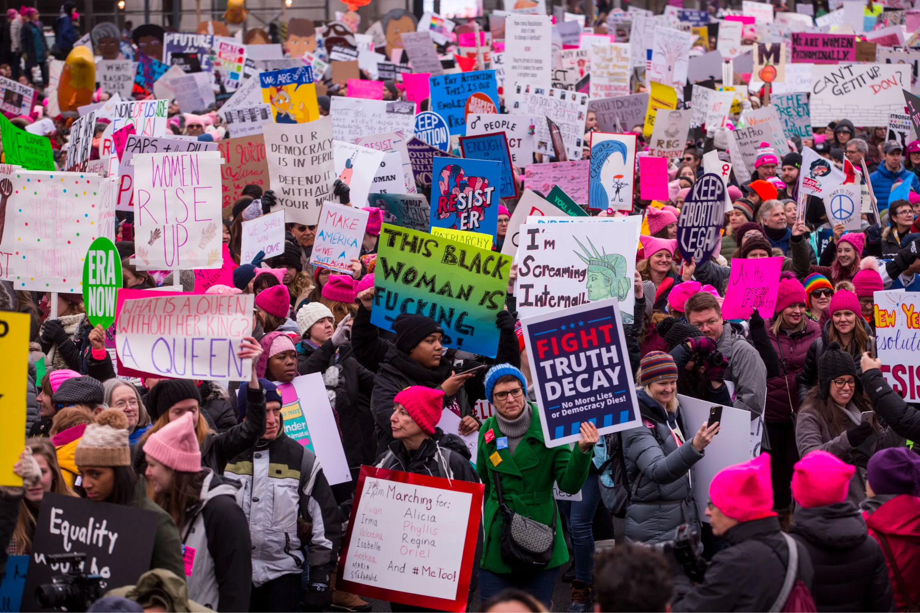
Activity 2:
Art as Activism
Notes:
Art has always been a powerful tool for social and political change.
Pass out art supplies (poster paper, markers, construction paper, gluesticks, etc) and have students work in groups of three to design a poster about a social issue that they all care about.
Show students some examples of protest signs as inspiration

Slide 14
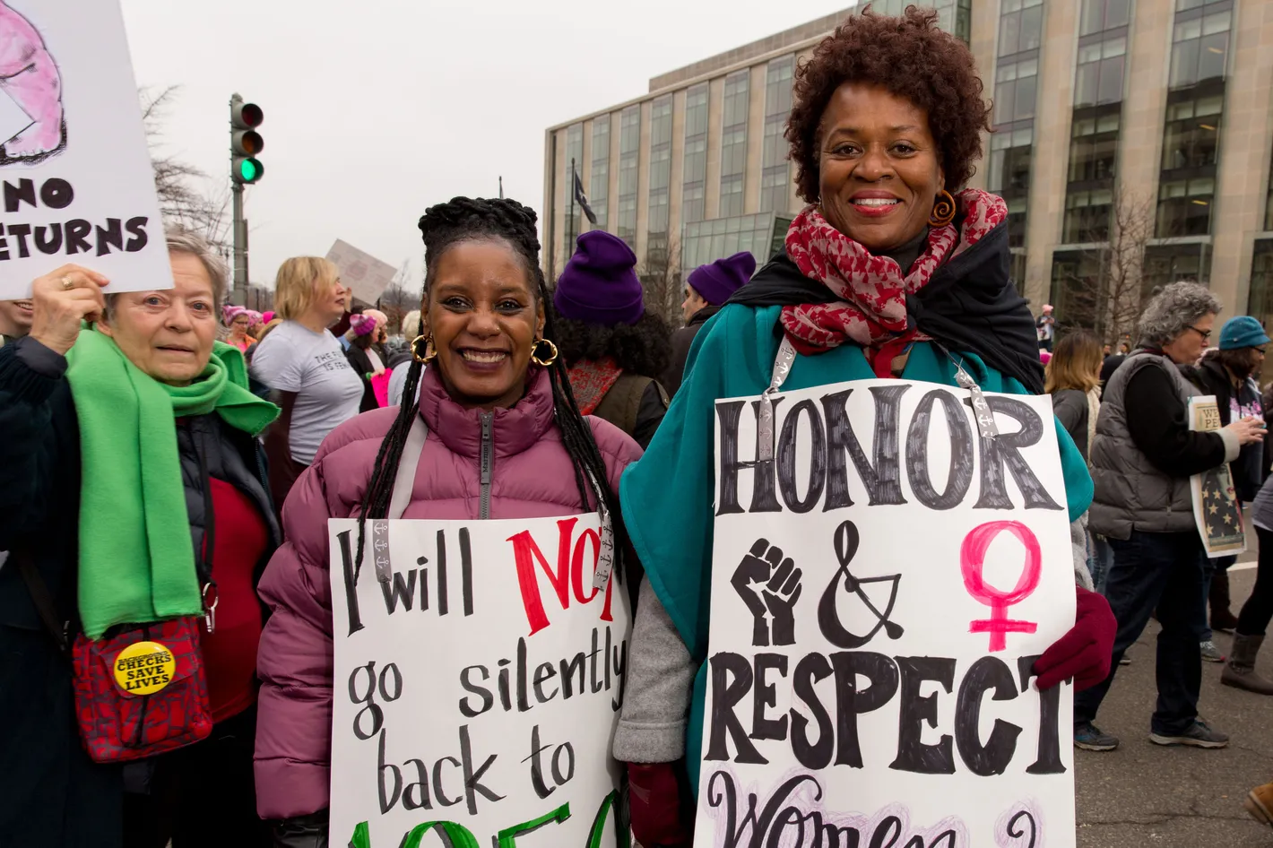
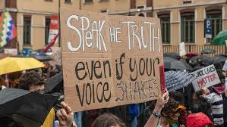
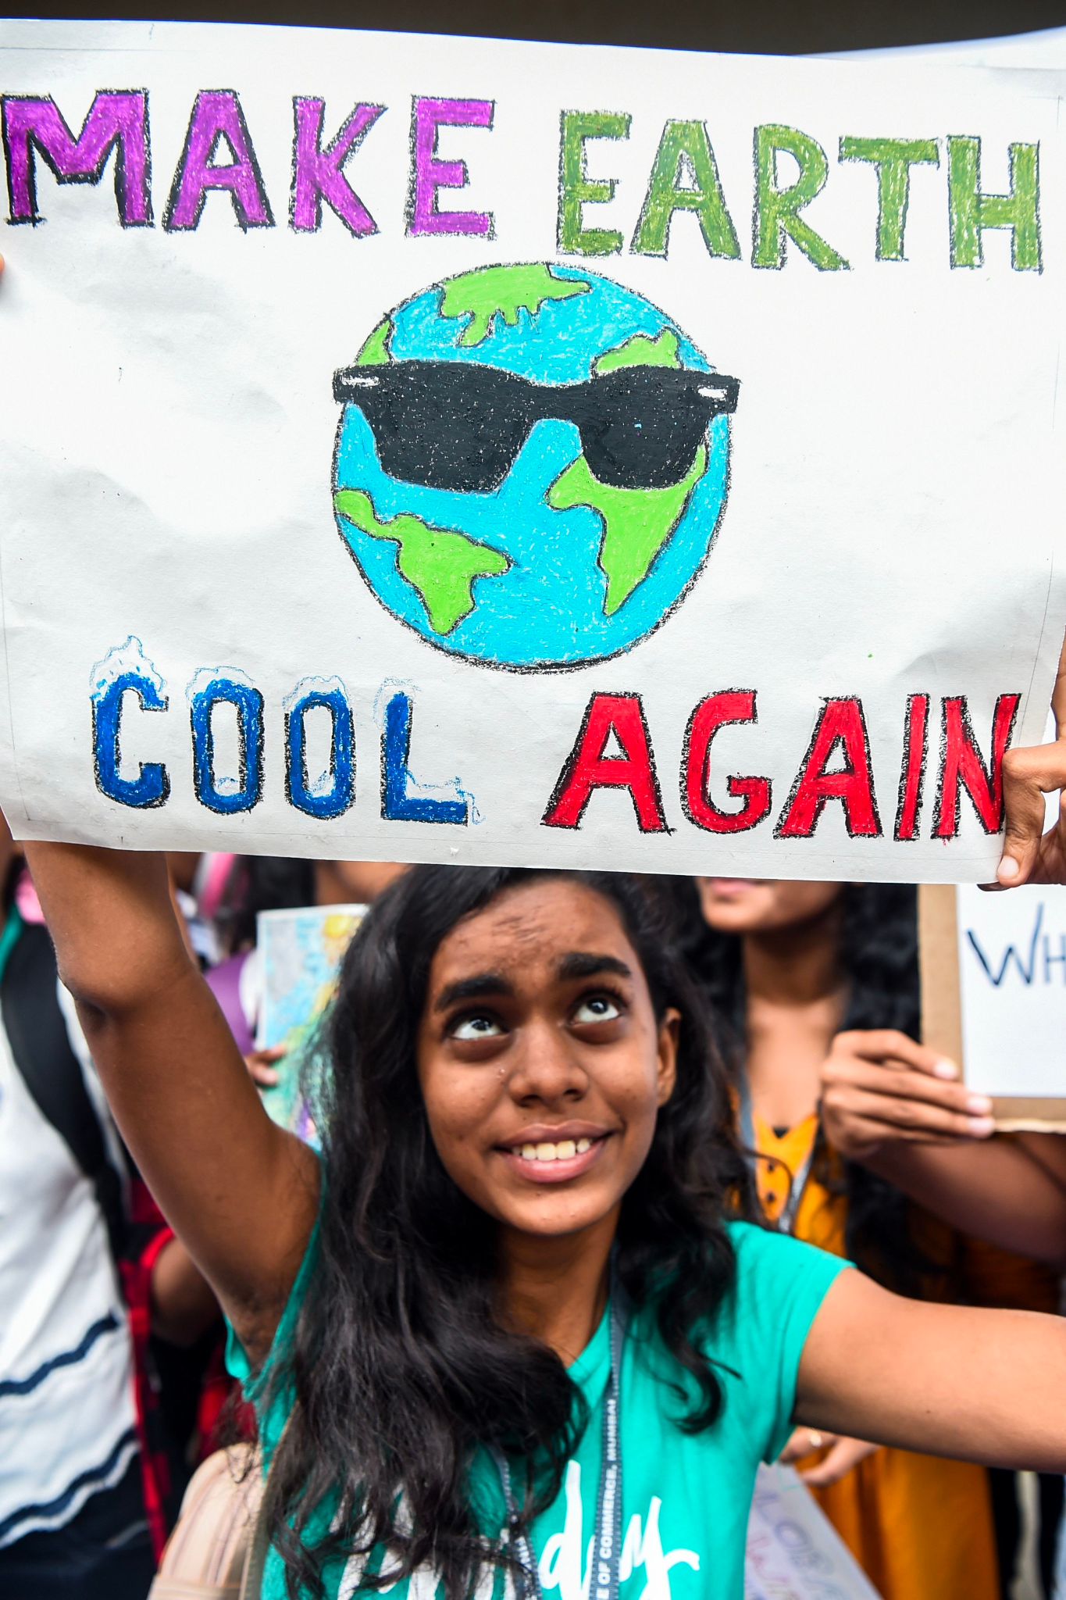
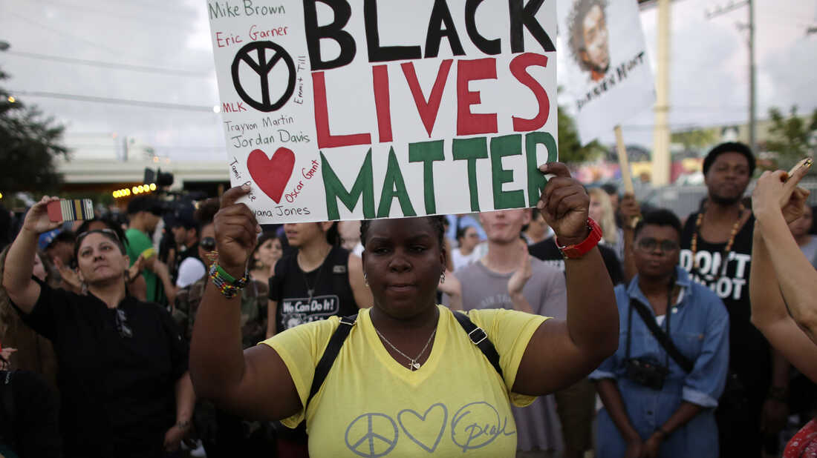
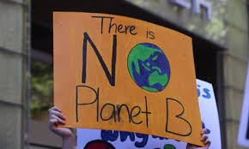
Notes:
Show students some examples of protest signs as inspiration and ask students what they think makes for a powerful march sign:
Powerful words
Color
Symbols of peace, love, unity, and resistance
Positive language

Slide 15
Share Out
Closing
Activism
Brainstorm

Slide 16
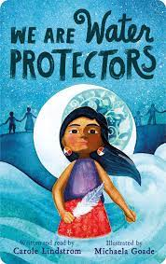
Extension Activity
Read We Are Water Protectors by Carole Lindstrom
This book focuses on indigenous-led movements to protect the water and land through environmental activism.
Activity Extensions: We Are Water Protectors - Macmillan
ASK STUDENTS
What is the main message of "We Are the Water Protectors"?
What is the importance and significance of water in the story?
What challenges do the characters in the book face?
How do the characters take action to protect the water?
What environmental issues do you care about and what can you do to address them?

Slide 17
Extended Learning for Educators
Navigating Difficult
Questions about Protests and Activism
SCENARIOS

Slide 18
Scenario #1
During the lesson a student asks, “What’s the point of marching? Nothing ever changes anyway.”
SOME STRATEGIES WE COULD CONSIDER:
Stay in a place of openness and curiosity?
“That’s an interesting point, what makes you think that?”
Validate the skepticism while also exploring the various goals of marching.
“Yes, its true that marches alone may not solve complex issues, but they can be one important part of a larger strategy for social change and activism.”
“Sometimes the impact of marches can be symbolic and emotional. They show solidarity and signal to others that they are not alone in the issues they care about.
“Sometimes marches can be educational and raise awareness of certain important issues, and they can inspire others to care about that issue as well.”
Provide examples of different ways people can stand up for what they believe in that doesn’t involve marching.
“Marching is not for everyone, and not the only way to support issues you care about. You can create art or music about issues you care about, you can volunteer or donate, you can read books and educate yourself about issues that are important to you.”
“The most important thing is feeling engaged in the world around you and finding small ways that you can make a positive difference.”

Slide 19
Scenario #2
During the lesson, a student shares that they feel scared when they see people marching in the street and that their parent says that “protesters are dangerous and damage property of local businesses.”
SOME STRATEGIES WE COULD CONSIDER:
Approach the conversation with empathy and acknowledge the students’ concerns about safety and property damage.
Distinguish Between peaceful protesters and non-peaceful protestors
“The majority of protesters are peaceful individuals who march as a way to express their views and advocate for change. However, sometimes there are individuals (usually a small minority) who use violence or property damage as a form of protest, but oftentimes those individuals don’t represent the entire movement.”
Discuss the role of law enforcement at marches
“Oftentimes, police will be present at marches, especially large ones. It is important for police and protestors to work together to ensure public safety and minimize negative interactions.”
“Appropriate behavior for law enforcement at a march should be to help manage crowds and traffic, ensure people are safe, and support the march to go smooth and peaceful.”
It’s ok to not always agree with protestors or activists, but as long as they are safe and peaceful, it’s important to respect their right to organize and protest the issues that matter to them.

Slide 20
Resources:
Sometimes People March_Edu Guide
Sometimes People March Literature Guide | Learning to Give
We Are Water Protectors - Macmillan

Slide 21
Email: info@pollyanna-us.org
Website: www.pollyanna-us.org
SOCIAL MEDIA
Facebook / Instagram: @us_pollyanna
LinkedIn: Pollyanna-us

Slide 22


