Slide 1

Thank You! How People Around the World Express Gratitude and Why
Grade 2 / Lesson 9
UNIT: Diversity Around the World––How Our Geography and Our Daily Lives Connect Us
Notes:
Gather students in a circle for the lesson in front of the projected slides.
For more reading on this topic: https://greatergood.berkeley.edu/article/item/how_cultural_differences_shape_your_gratitude

Slide 2


Photo by Max van den Oetelaar on Unsplash
Notes:
Invite students to wiggle their bodies into a comfortable position and then lead them through a simple breathing or mindfulness exercise.
Examples:
1-minute of mindful breathing
(fake) Yawn & 10 second stretch - notice and “greet” any tension or tightness
Self-Love Hug w/ 3 deep breaths
Hand stroke - with eyes cast or closed, using index finger of one hand, gently trace the outside of all fingers on the opposite hand, then switch hands
full body scan - noticing any tension, sensations, or emotions in different parts of the body
Remind students that slowing down to breath in this way helps us to stay calm and focused.

Slide 3

Photo by Courtney Hedger on Unsplash
Notes:
Today we are going to talk about saying thank you and showing gratitude.
When do we usually say “thank you” to another person? What are some examples?

Slide 4
  When someone opens the door for us
  When someone gives us food or a drink
  When someone gives us a gift
  When someone gives us a compliment
  When someone makes us laugh or gives us a listening ear when we feel sad
Notes:
Review these ideas with students as a complement to ones they’ve already shared.

Slide 5
Photo by Courtney Hedger on Unsplash
Notes:
Ask students: Why do we say thank you?

Slide 6
  To practice our values
  To show that we are thankful
  To make them feel good
  To show that we care
  To show that we understand that they did something nice for us
Notes:
Review these ideas with students as a complement to ones they’ve already shared.

Slide 7


Notes:
Share that we are now going to read a beautiful story about gratitude being our superpower.
Ask students, what is a super power? What are some examples? (e.g. flying, speed – being able to run really fast, super strength – being able to lift big objects)
A super power lets us do amazing things. Let’s listen to find out what gratitude lets us do.

Slide 9

Notes:
Click to listen to the story.

Slide 10
Notes:
Ask students: What is one thing you learned from this story?

Slide 11
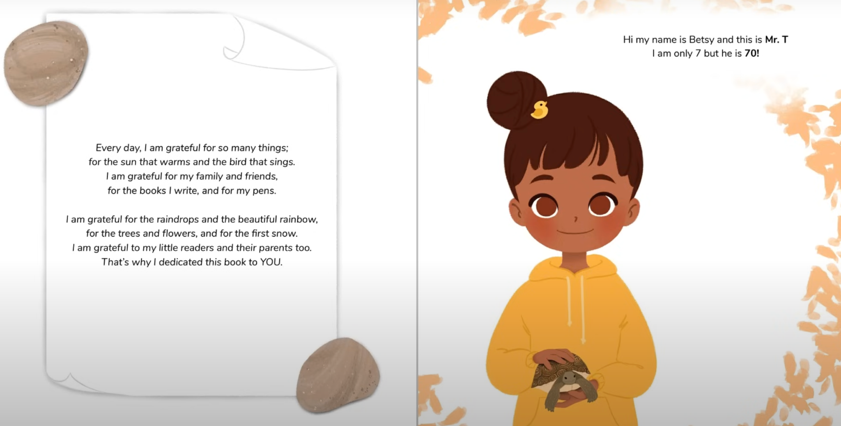
Notes:
We learn that the author of the book has many things to be grateful for like the sun that warms and the bird that sings, family and friends, books and pets. I want each of you to think about one thing that you are grateful for.
Now I want you to return to your desks.

Slide 12
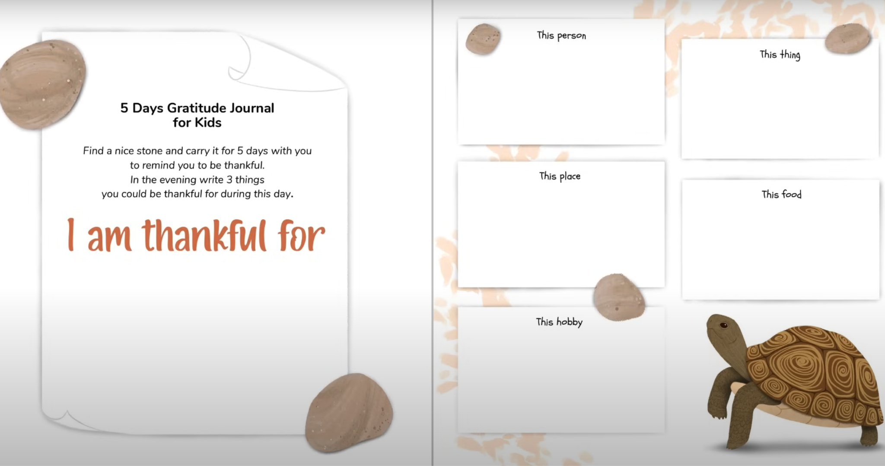

Slide 13

Photo by Juliana Kozoski on Unsplash
Notes:
Thank you so much for participating in that exercise, students!
People show gratitude by saying thank you, but “thank you” sounds differently around the world in different languages.
When I say “thank you” what language am I speaking?
English is correct!
Does anyone know how to say thank you in another language?
I’m hearing a couple of good examples.
Let’s watch a short video where we will learn about saying thank you in different languages.

Slide 14

Notes:
Play video twice, and encourage students to sing along the second time.

Slide 15
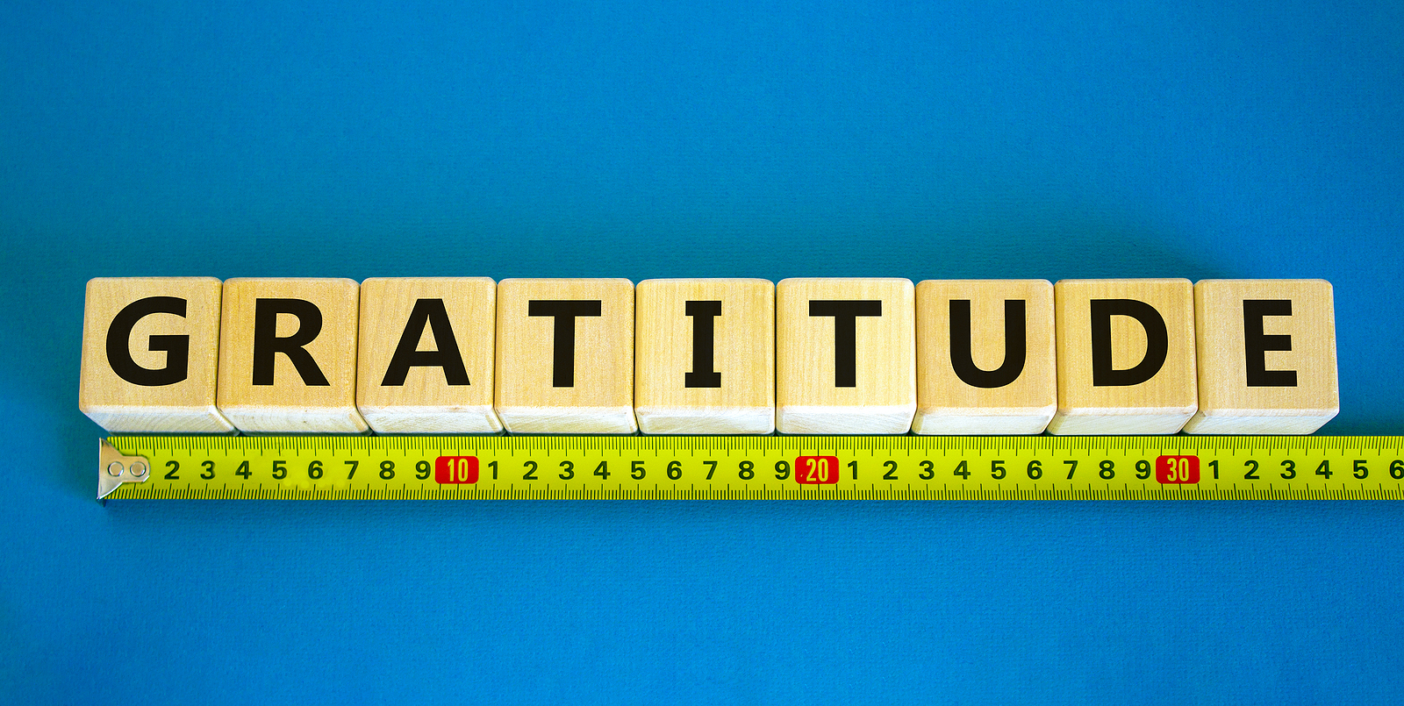
English | Thank You
French
Spanish
Korean
Japanese
Germany
Hindi
Hebrew
Greek
Swahili
Arabic
Chinese
Italian

Slide 16
English | Thank You
French | Merci
Spanish | Gracias
Korean | Gomawo
Japanese | Arigato
Germany | Danke
Hindi | Dhanyavaad
Hebrew | Toda
Greek | Efcharisto
Swahili | Asante
Arabic | Shukran
Chinese | Xièxiè
Italian | Grazie

Slide 17




Slide 18
Extended Learning for Educators
Navigating Tricky Comments
SCENARIO

Slide 19
Scenario
A student says “Well, I’m grateful because I have the biggest house ever.”
SOME STRATEGIES WE COULD CONSIDER:
Students at times make comments that they do not realize implies something could be harmful to other students. For instance, others could feel that their homes are not as nice as this student’s home or could feel like this student was putting them down. This is a good opportunity to help a student reframe their comment. You can do so in a non-shaming way by maintaining a calm tone, affirming the spirit of their gratitude statement, and offering them better language to use.
Affirm the spirit of their gratitude statement.
“Thank you so much for sharing your gratitude statement with us.”
“It sounds like you are really grateful for your home.”
“I am appreciating hearing what you are grateful for.”
Reframe their comment toward greater inclusivity.
“It sounds like your home keeps you safe and it is a good place to be. The size of our homes does not matter as long as we feel good in it.”
“It is good to hear how much you like your home. What makes a home special is not its size, but the love inside of it. All homes, regardless of their size, can be special.”

Slide 20
Email: info@pollyanna-us.org
Website: www.pollyanna-us.org
SOCIAL MEDIA
Facebook / Instagram: @us_pollyanna
LinkedIn: Pollyanna-us

Slide 21


