Slide 1
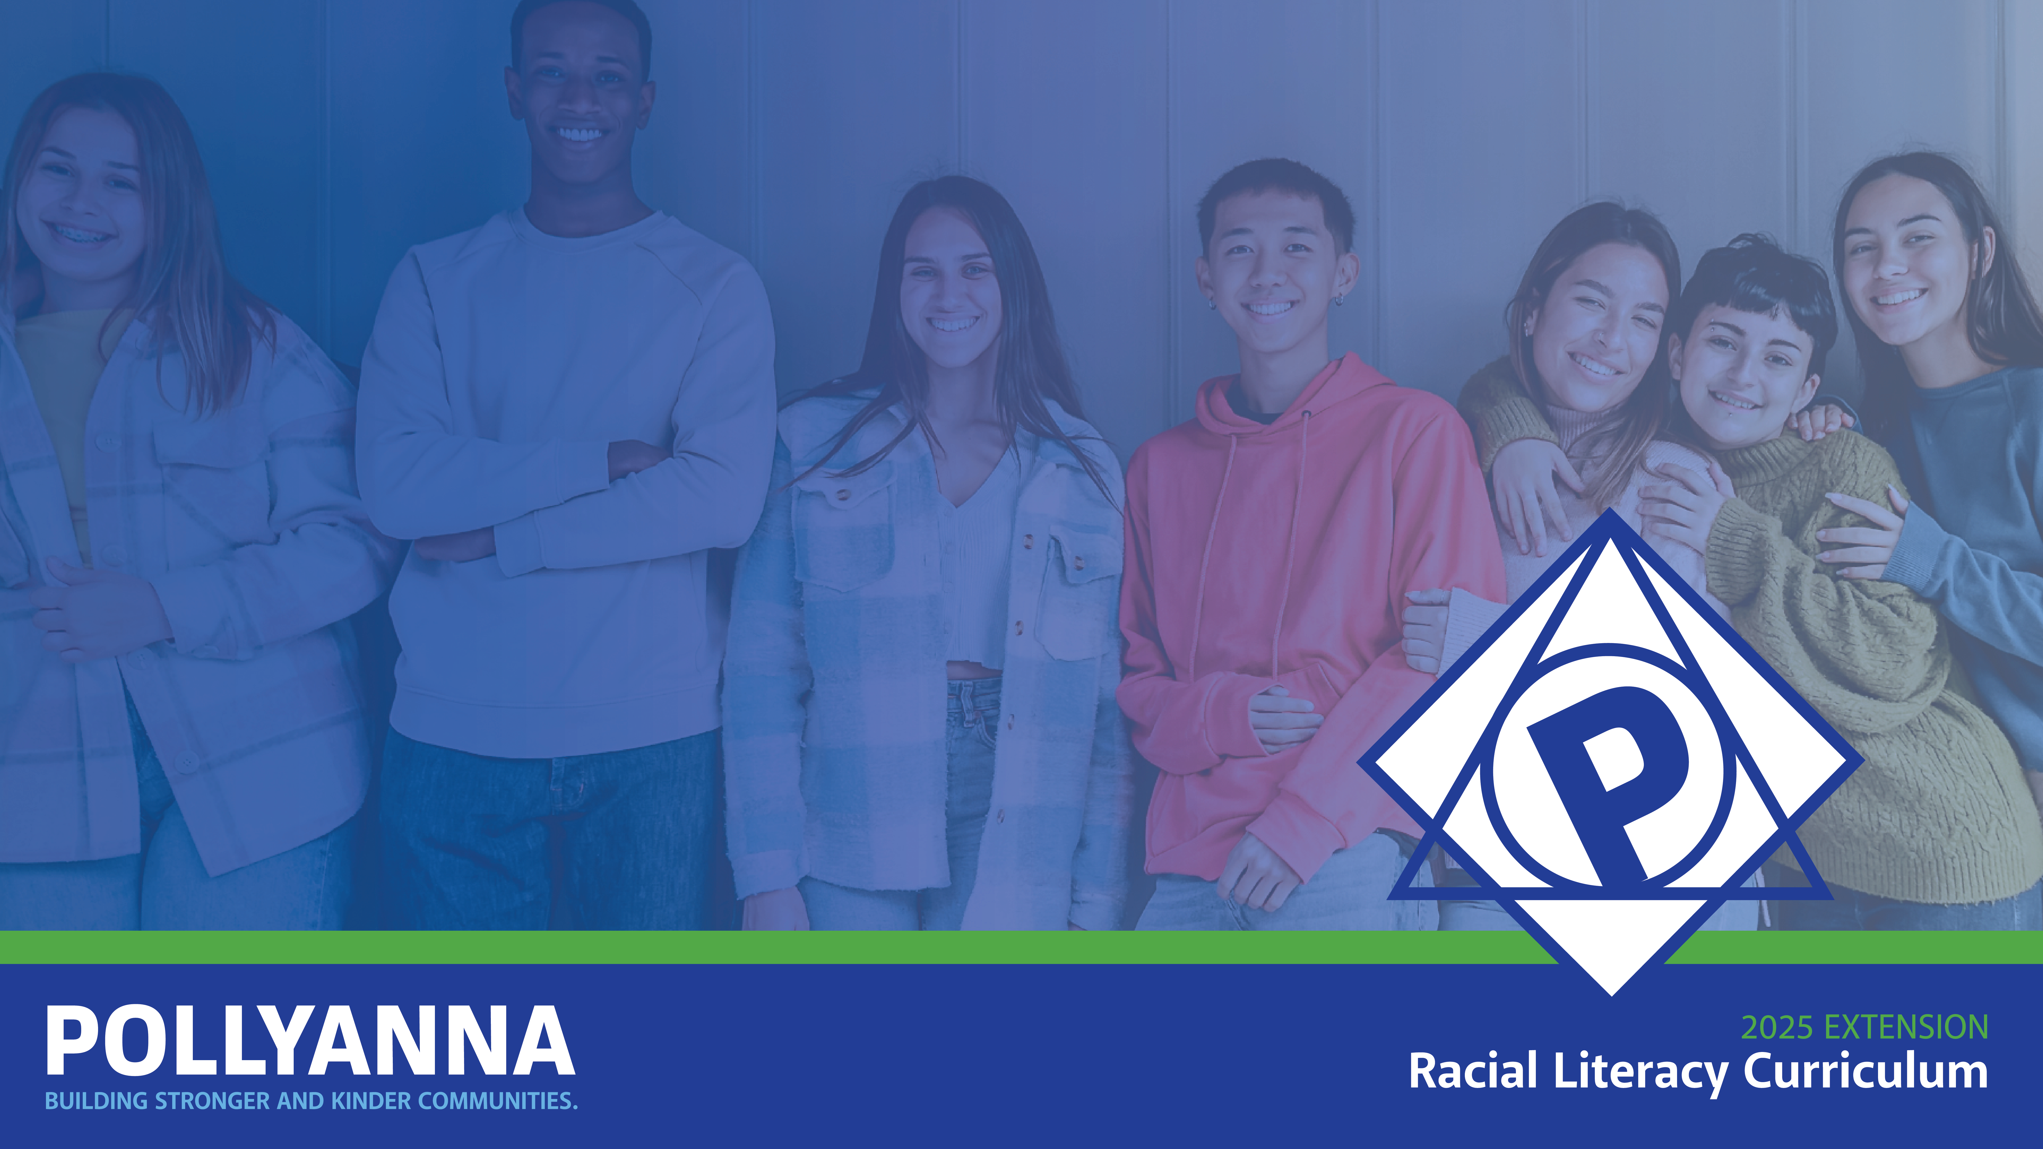
Celebrating our Cultural Heritage and Ancestry
Grade I / Lesson 9
UNIT: We Are Part of a Larger Community – Encouraging Kindness, Social Awareness, & Empathy

Slide 2

Agenda
  Lesson objective
  Invitations
  Vocabulary
  What is cultural heritage?
  What are ancestors?
  Read Aloud: “Where are you From?”
  Dialogue on our cultural heritage
  Closing

Slide 3
Objectives
  Think about our own cultural heritage and ancestry.
  Consider ways we can celebrate and feel connected to our cultural heritage and ancestry.
  Share our heritage with others and celebrate the similarities and differences.
Notes:
Explain to students that today we will be thinking about our own cultural heritage and ancestry and consider ways we can celebrate and feel connected to those identities.
Also, practice sharing our cultural heritages and ancestries with one another and celebrating the similarities and differences.

Slide 4
Invitations
  Be fully present
  Have an open mind and heart
  Be curious
  Be willing to share
  Be open to reflect
  Listen respectfully

Slide 5
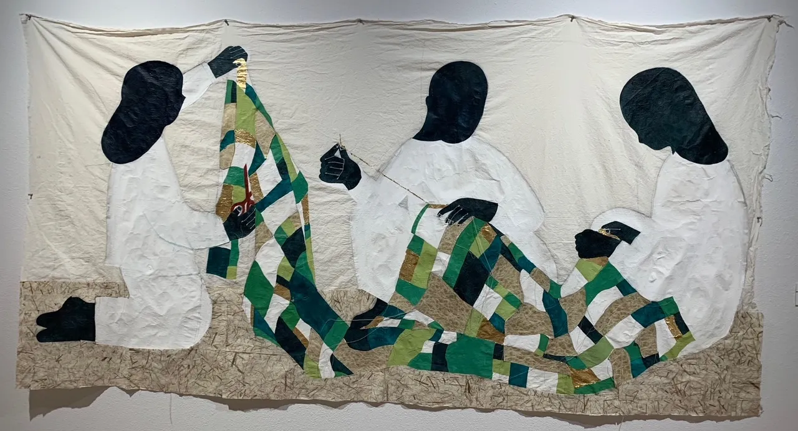
What is cultural heritage?
Cultural heritage is all about the special things that make us who we are and connect us to our families and where we come from.
It's like a special thread that ties us together with our ancestors, the people who came before us and the people who will come after us.
“Family Tree (female)” by Lyssa Park.
Photo: Melisa Christ
Notes:
Imagine your family has special traditions, like celebrating holidays in a certain way, or maybe your grandma has a special recipe that has been in the family for a long time. That's part of your cultural heritage! It's like a big collection of stories, customs, and things that are important to the people in your family and community.
Teacher should offer an example of something from their own cultural heritage
“In my family we cook a big family breakfast on Sunday mornings”
“In my culture we do a big party and celebration for someone’s 15th birthday”
“In my family’s tradition we tell stories after dinner”

Slide 6
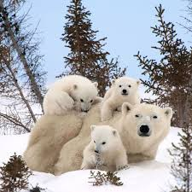
What makes a family?
  A family is a group of people who love and care for each other!
  Families can look and feel different.
  What's important is the love and support they share.
Notes:
Notes for different types of families:
Some families have a mom, a dad, and kids while others might have just one parent, or maybe grandparents taking care of the kids. Some families might have step-siblings or adopted children. There are families with two moms or two dads, and some families are made of friends who are like family.
If students ask about step-family members you can say:
“a stepfamily is when two families come together to make one big family. You might get new step-siblings, which means brothers or sisters from your mom's or dad's new partner. Sometimes, you even get new aunts, uncles, or grandparents from the other side of the family!”
If students ask about adoption you can say:
"Adoption is a special way that some families come together. When a child is adopted, it means that their birth family, for different reasons, asked another family to take care of and love them forever. The family that adopts them becomes their forever family.”

Slide 7
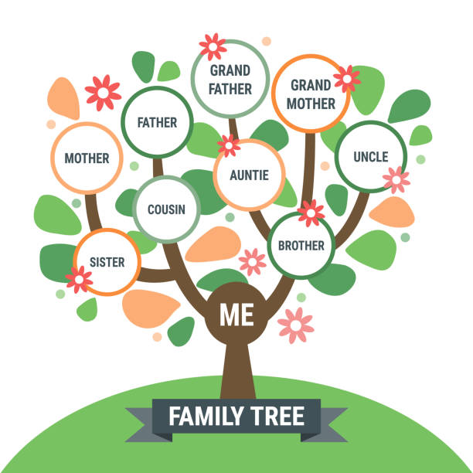
What is an ancestor?
  An ancestor is someone from your family that came before you.
  Such as your grandmother’s grandmother and all the relatives before her are examples of ancestors.
Notes:
Taken from
Pollyanna Class K: Talking about Skin Tones and Skin Colors
If the teacher knows where their ancestors are from they should share:
“My ancestors come from Jamaica”
“My ancestors come from the American South, Georgia to be precise”
“My ancestors are from all over Europe. Ireland, England, and Italy”

Slide 8
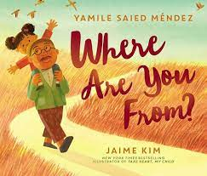
Activity:
Real Aloud

Slide 9
Let’s Discuss!
Notes:
Where Are You From? by Yamile Saied Mendez Illustrated by Jaime Kim || Read Aloud Read Along || (Youtube)
Guiding Questions for Students:
What are the main character’s feelings and why does she feel like she doesn’t belong?
Why do you think she turns to her grandfather for help?
Where do you think the main character is from based on her grandfather’s description? Is she from one single place?
Can you think of things in your family or culture that are special and unique, like the things the grandfather mentions?
How do you think learning about our heritage and where we come from can help us understand ourselves better?

Slide 10
What is your
cultural heritage?
Notes:
Consider that some students may be excited to talk and share about this topic and know a lot about it. Other students may be shy or unsure about their cultural heritage, which is fine!
If students seem unsure encourage them to focus more on family traditions, foods, holidays they celebrate, activities they do with their families. Examples on the next slide!
Be aware that for some students, ancestry and cultural heritage can be tied to difficult and painful legacies of enslavement, forced migration, displacement, etc. Although these topics can be emotional, it is important to honor and acknowledge a student’s families lived experience and true history if they share.

Slide 11
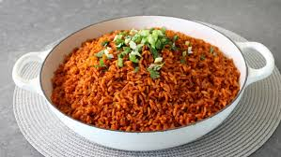
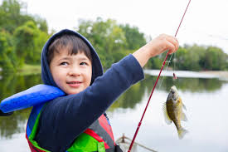
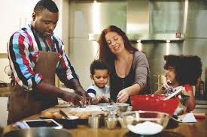

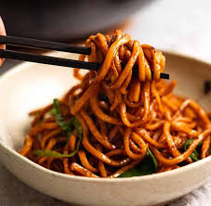
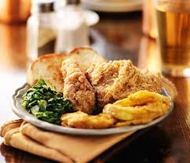
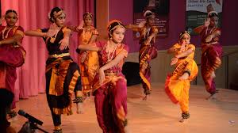
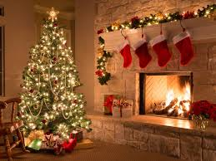
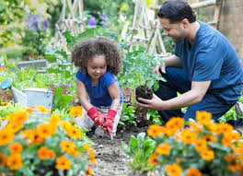
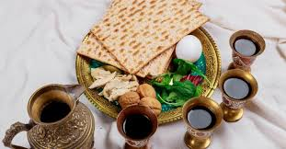
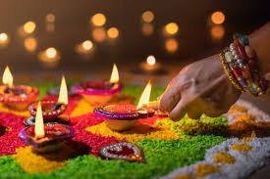
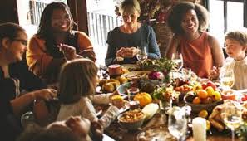
Food
Activities
Holidays
Notes:
Consider that some students may be excited to talk and share about this topic and know a lot about it. Other students may be shy or unsure about their ancestry or cultural heritage, which is fine!
If students seem unsure encourage them to focus more on family traditions, foods, holidays they celebrate, activities they do with their families instead of ancestry.
Be aware that for some students, ancestry and cultural heritage can be tied to difficult and painful legacies of enslavement, forced migration, displacement, etc. Although these topics can be emotional, it is important to honor and acknowledge a student’s families lived experience and true history if they share.

Slide 12
Closing
What are some things we can do with our cultural heritage?
  Understand it and learn about it
  Care for it
  Educate and share it with others
  Enjoy it
Notes:
Ask students to come up with how we could do each other these things:
Understand it and learn about it
Ask our parents or grandparents about our cultural heritage
Read books or watch movies or shows about our cultural heritage
Learn how to make a recipe from our cultural heritage
Care for it
Support our community through acts of service
Clean or care for the special objects or artifacts from our cultural traditions (clothes, cookware, quilts, jewelry, etc)
Educate and share with others
Talk about our cultural heritage with classmates
Invite friends to join and participate in our cultural heritage activities
Enjoy it
Eat the food
Do the activities with people we love
Feel proud of our heritage

Slide 13
Extension Activity
Read You Hold Me Up by Monique Gray Smith
ASK STUDENTS
How do the characters in the book show kindness and support for one another?
How do the illustrations in the book make you feel? How do they add to the story?
What are some activities characters do in the book that could be tied to their cultural heritages?

Slide 14
Extended Learning for Educators
Navigating Difficult
Questions about Ancestry
SCENARIOS

Slide 15
Scenario #1
A student asks another student, “Why don’t you look like your mom?
SOME STRATEGIES WE COULD CONSIDER:
Keep the conversation positive, and focus on the values of kindness and sensitivity. This can help children understand and appreciate the uniqueness of each family and individual.
Acknowledge the question and respond in a way that acknowledges diverse families.
"That's an interesting question! People can look different from their moms for lots of reasons.”
“Sometimes our appearances come from a mix of our parents' traits.
“Not all families have a shared ancestry. Everyone's family is unique, and people can look different even if they're part of the same family. It's what makes each family special."
"Just like how we all have different hair colors or eye colors, our features can vary. It's what makes each person unique and interesting."
Model for the student a more appropriate way to learn about their friends:
"If you're curious about someone, it's always good to ask positive questions like 'What do you like to do with your mom?' or 'What makes your family special?'"

Slide 16
Scenario #2
During the lesson, a student shares that they don’t know their ancestry because they are adopted and other students in the class ask, “what’s adopted?”
SOME STRATEGIES WE COULD CONSIDER:
This is a great opportunity to uplift and celebrate diverse families!
Respond with warmth and openness.
"Thank you for sharing that with us.”
"Adoption is a wonderful way to build families. It's an important way that many families are created, and it makes each family even more special."
"That's great! Families come together in all sorts of ways, and what matters most is the love and care within the family.”
Give a brief and general explanation of adoption ONLY IF students continue to ask or express confusion.
"Adoption is a special way that some families come together. When a child is adopted, it means that their birth family, for different reasons, asked another family to take care of and love them forever. The family that adopts them becomes their forever family.”
“Families can be made in different ways. Some families have babies who grow in their mommy's tummy, and some families have children who join them through adoption.”
*Consider reaching out to the child’s family to let them know the topic came up in class and share how you approached it, in case they want to follow-up with their child.
Notes:
https://www.indianaadoptionprogram.org/wp-content/uploads/2022/08/Supporting-a-Student-who-is-Adopted-NACAC.pdf#:~:text=Talk%20about%20adoption%20in%20a,and%20watch%20for%20their%20reactions.

Slide 17
Email: info@pollyanna-us.org
Website: www.pollyanna-us.org
SOCIAL MEDIA
Facebook / Instagram: @us_pollyanna
LinkedIn: Pollyanna-us

Slide 18


